Slide 1
Last Several Weeks
Next Week(s)
4/12/19
Proximity Graphs
Lots of help from Di (Thank you)
Three analyses:
2D Quality Measures
Topological Stability
SVM Data Reduction
Last chapter of Dissertation
Uncertain Topology
Paper not submitted
SpotSDC
Good work Zhimin
Finalize Dissertation Document
Defense Slides
Geospatial High-Dimensional Visualization Project
Uncertain topology meeting

Slide 2
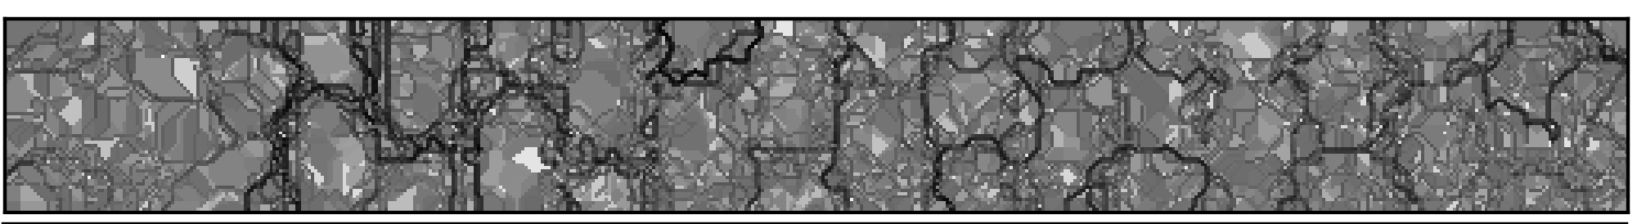
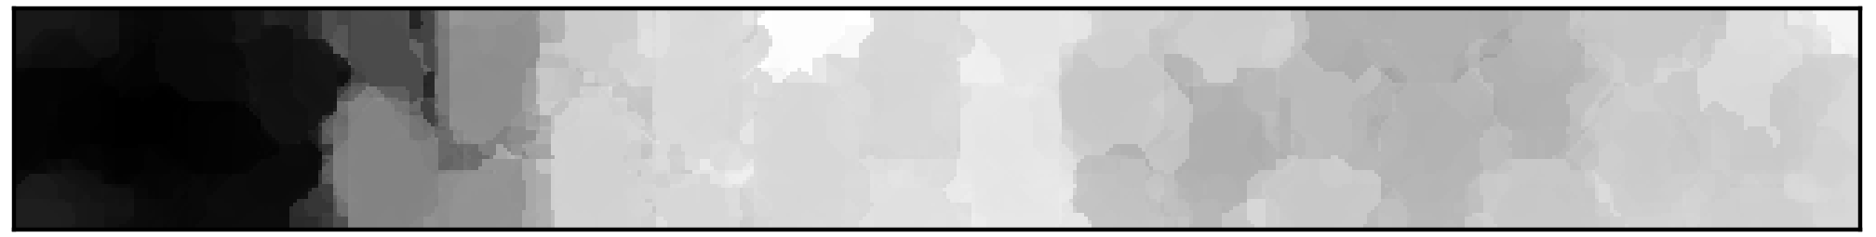

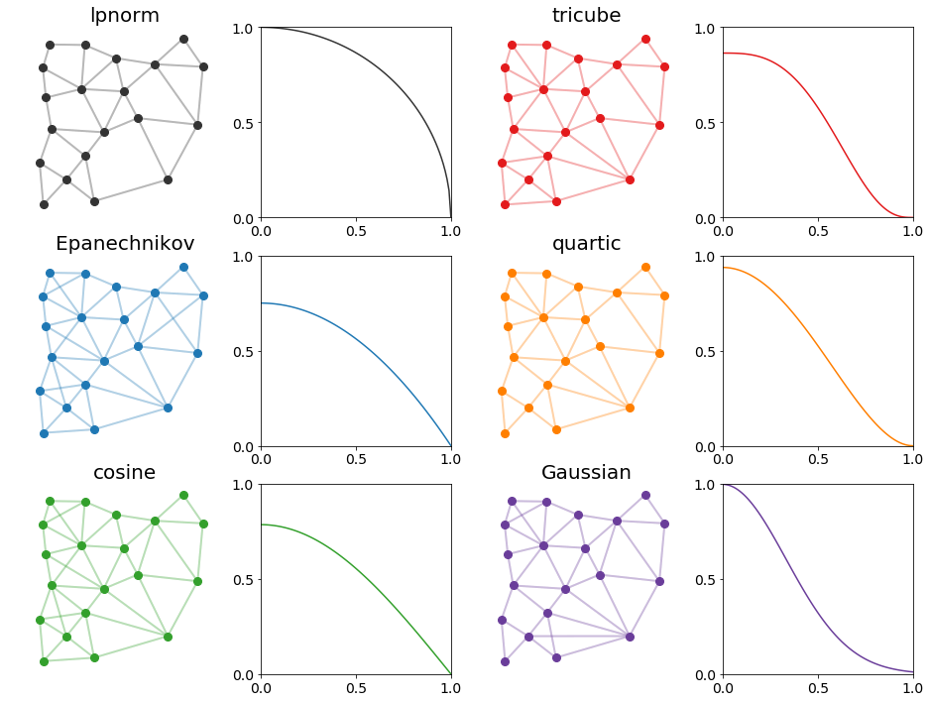
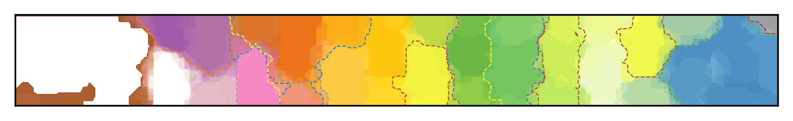
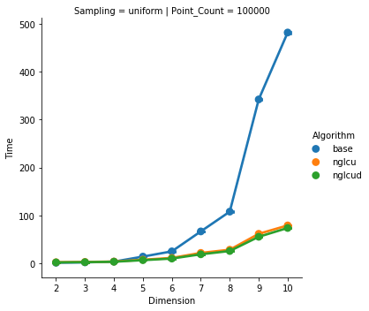
This Week
Next Week(s)
3/22/19
Uncertain Topology
Debugging some visualizations of uncertain topology
Meeting with Tushar to discuss remaining visualizations and combinations of existing techniques
Proximity Graphs
Writing theory, algorithms, and formulas
Example with generic shapes for empty region
Uncertain Topology
Trello board to organize remaining work
Read and edit writing
Scalable Topology
Edit down section on graphs
Proximity Graphs
Running lots of experiments
Clean up the writing
Ensure there is no overlap with scalable topology submission
Rerunning performance benchmark
Finding more related works
SpotSDC
Finalizing

Slide 3
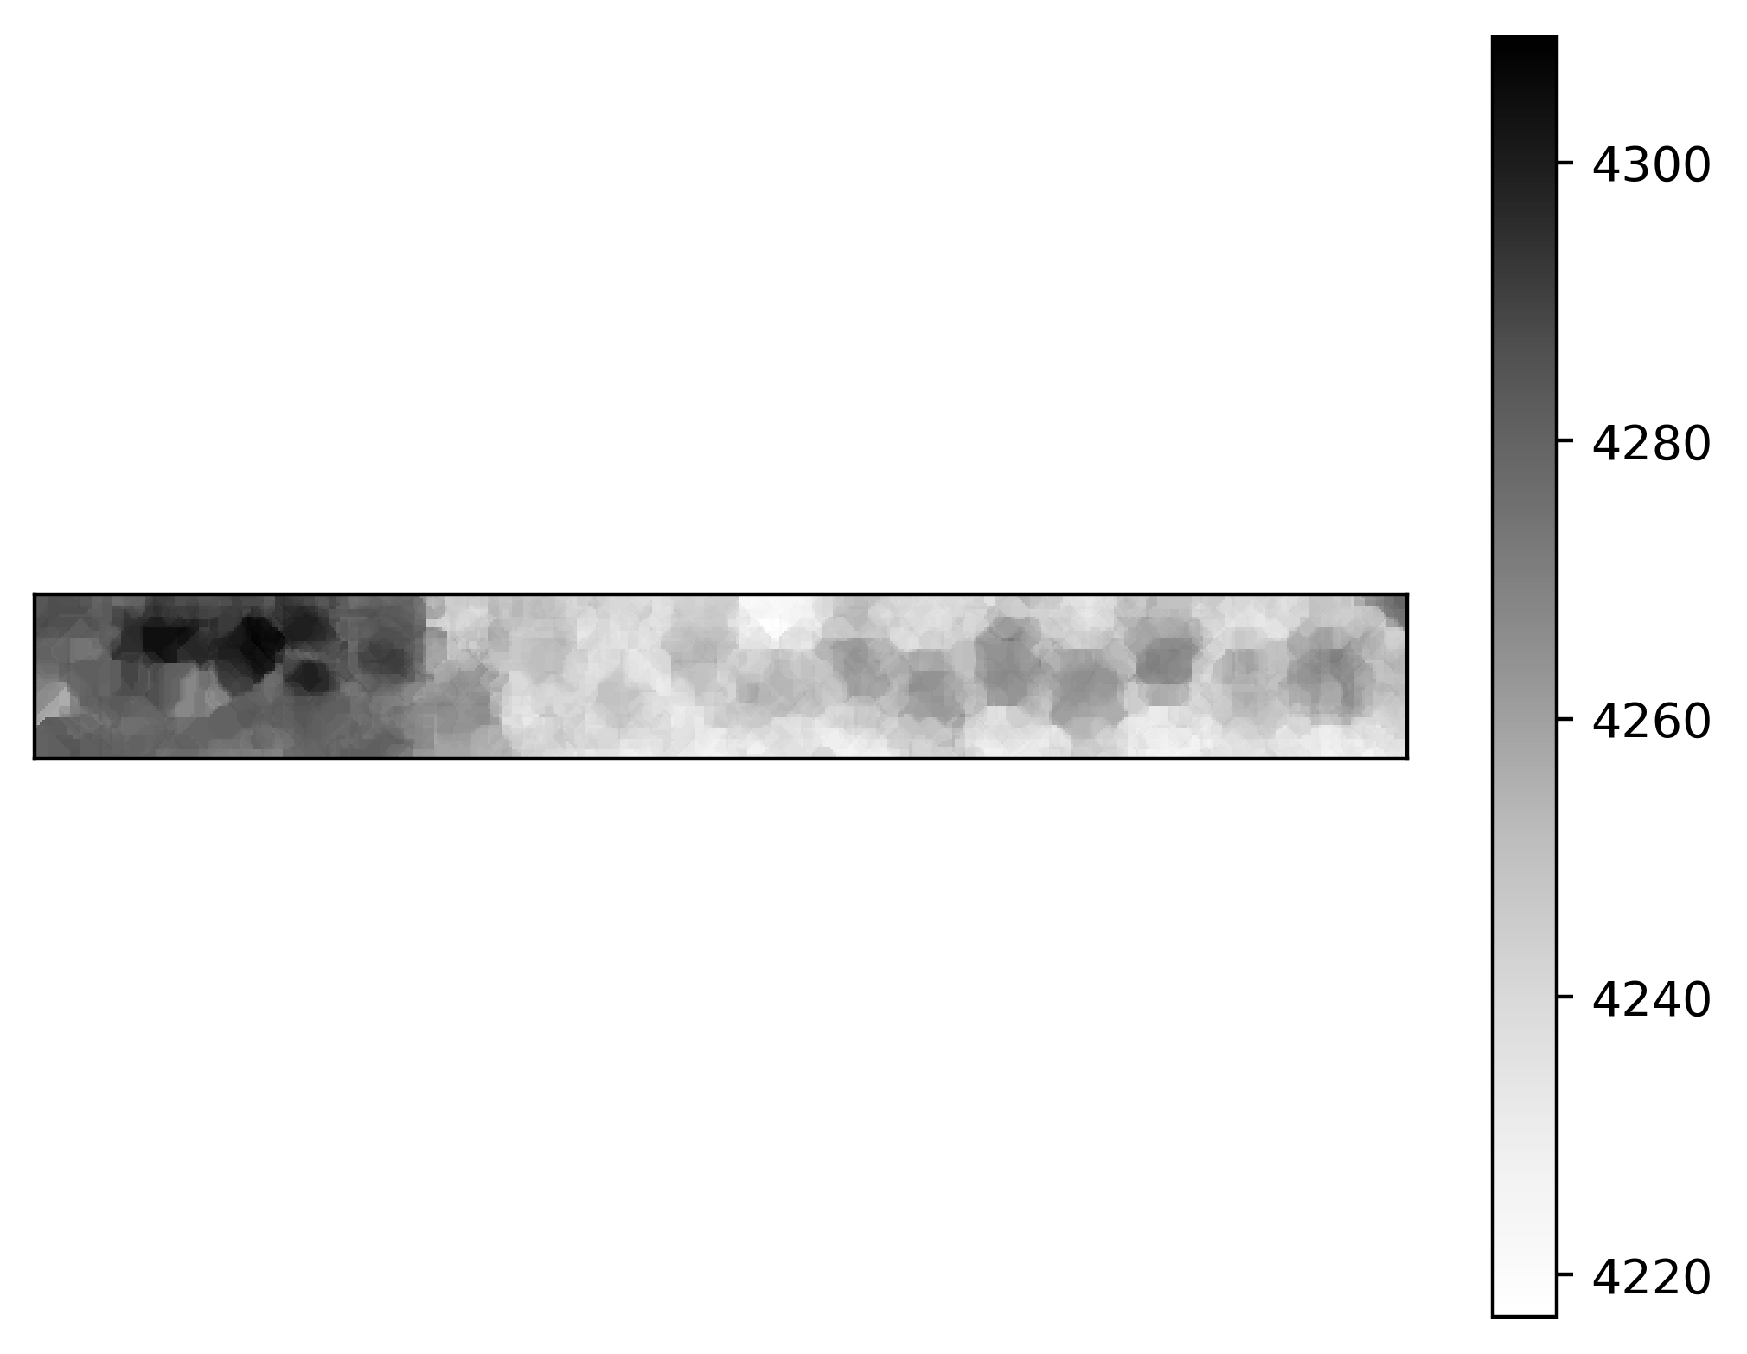
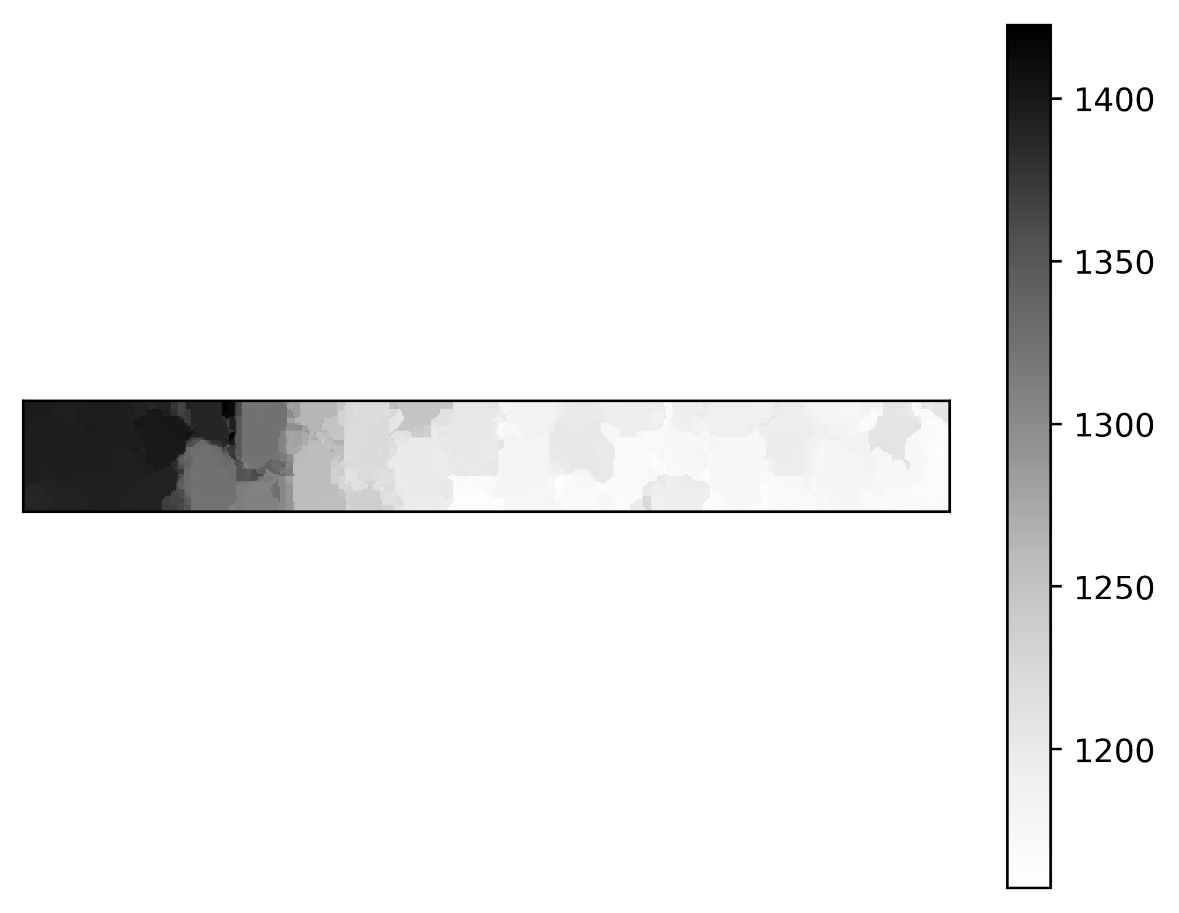
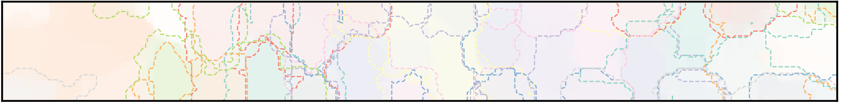
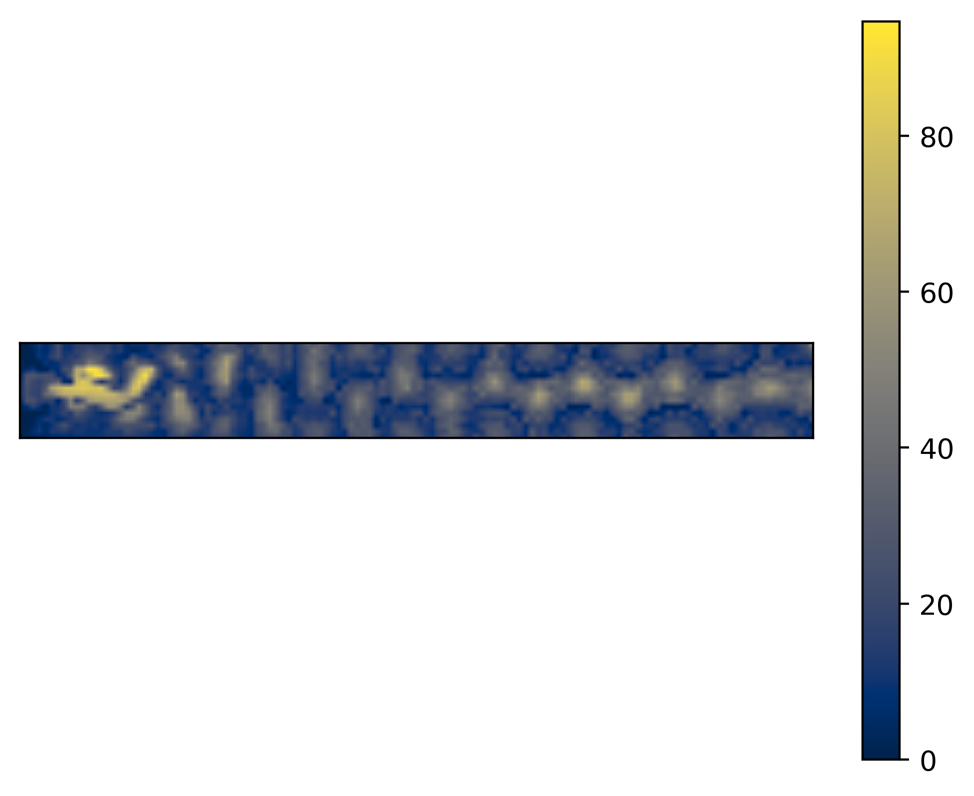

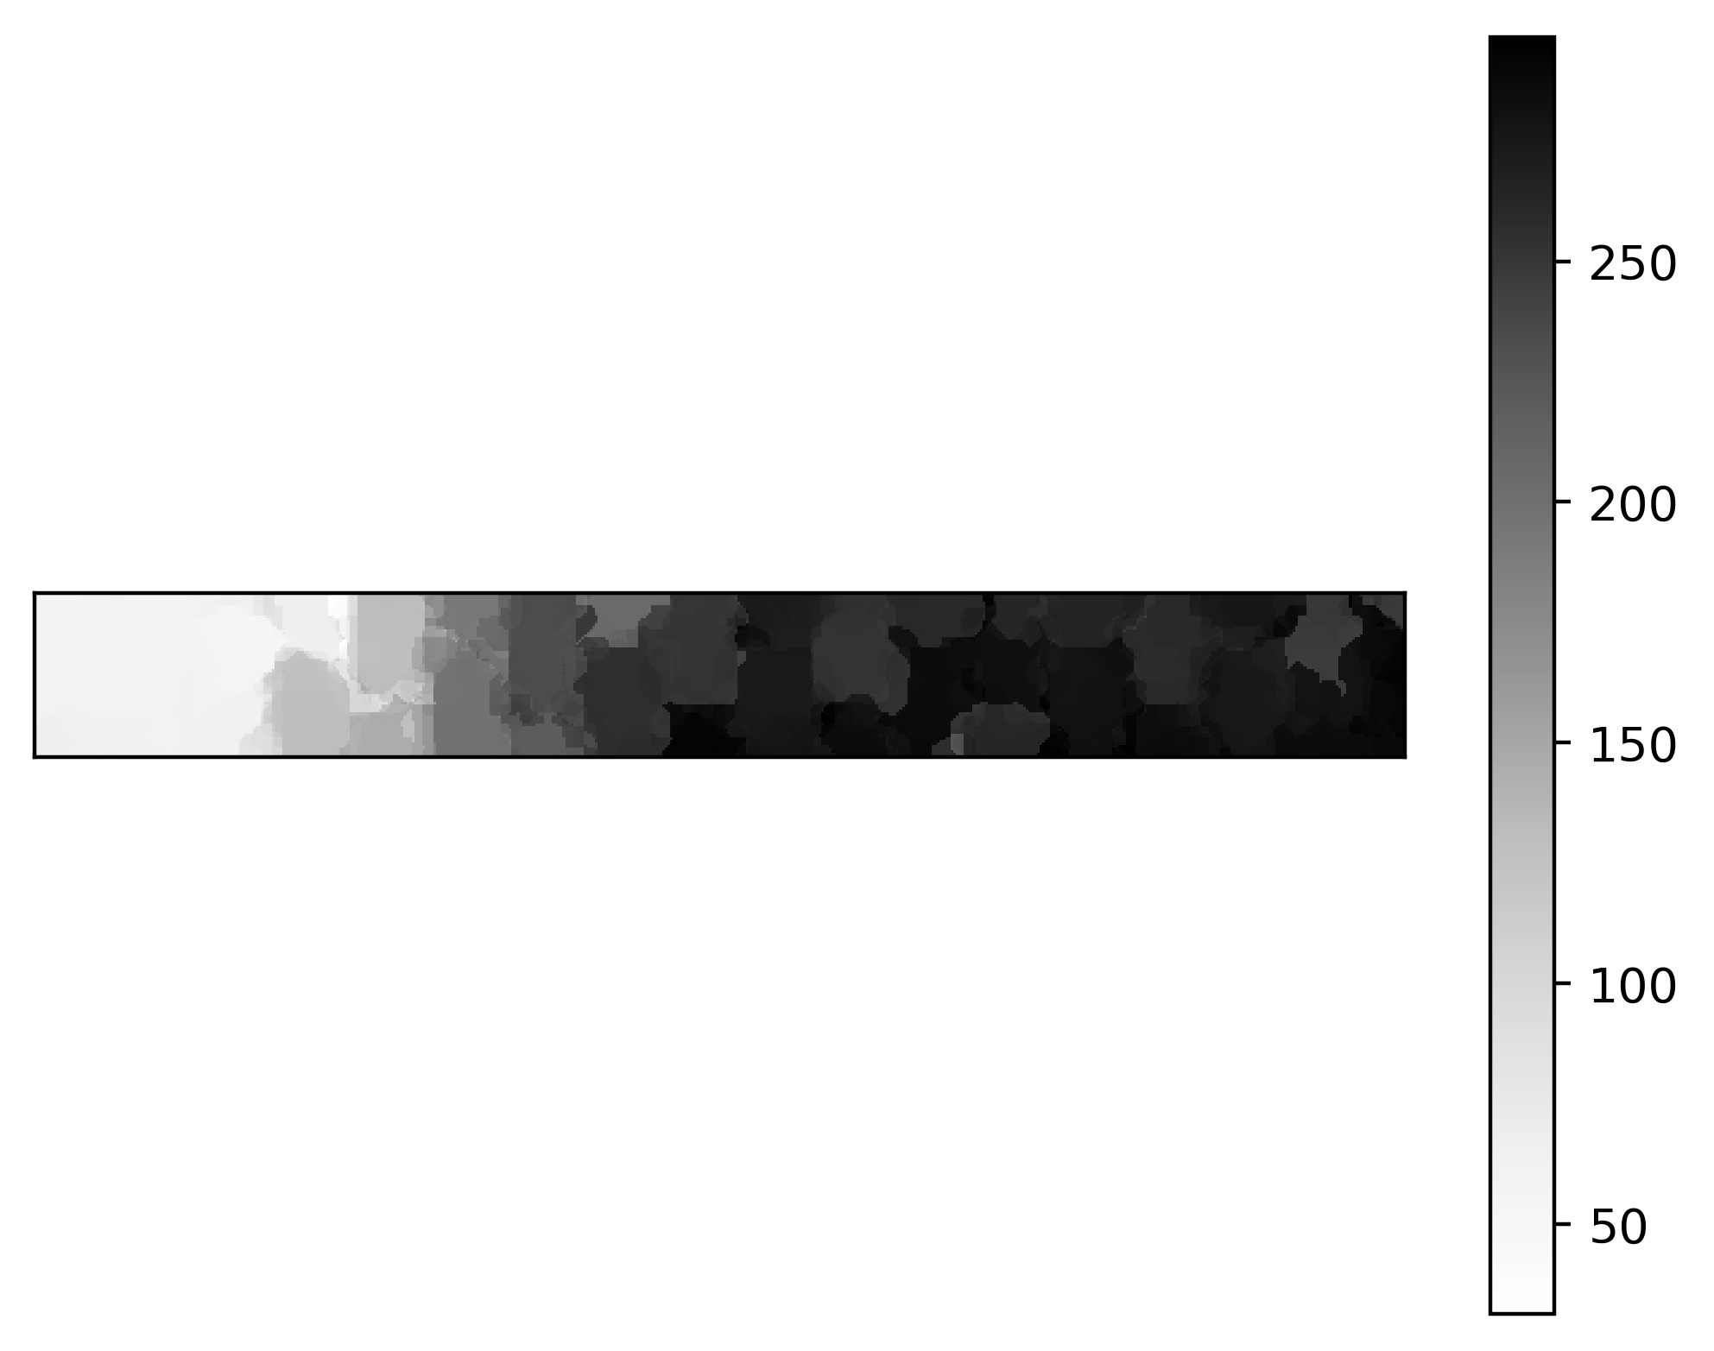
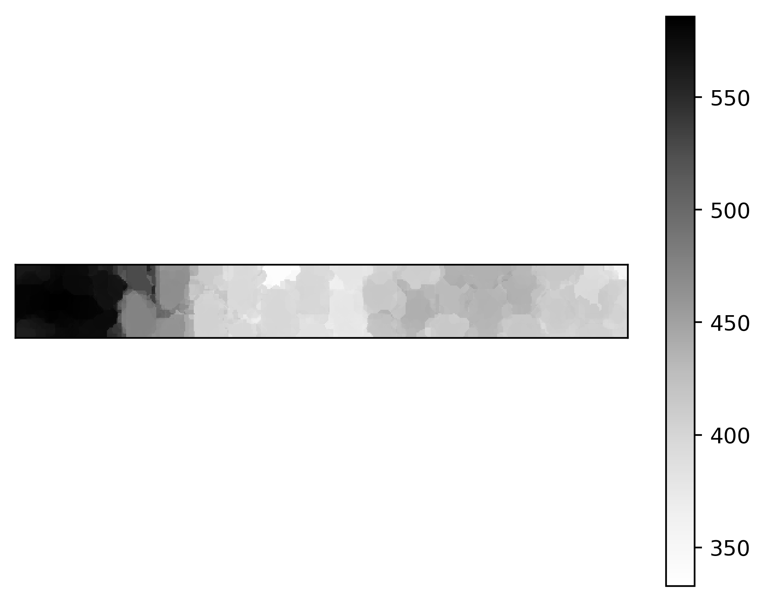
This Week
Next Week(s)
3/15/19
Uncertain Topology
Clustering of survival count plots
Generating lots of data
Proximity Graphs
Paper repo (very rough draft)
Any high-level comments would be useful
Writing technique down for:
ERG
Approximation
Discrete
Probabilistic (to do)
Cone-based
Approximation
Probabilistic
Uncertain Topology
Trello board to organize remaining work
Proximity Graphs
Probabilistic cone graph implementation
Clean up the writing
Ensure this is not overlapping too much with scalable topology submission:
Scalable topology focuses on streaming graph computation mentions GPU
This work generalizes the graph and deep dives into GPU computation and probabilistic setting
Example with generic shapes for empty region

Slide 4
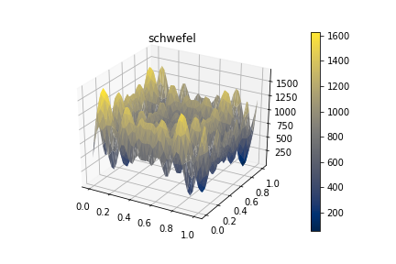
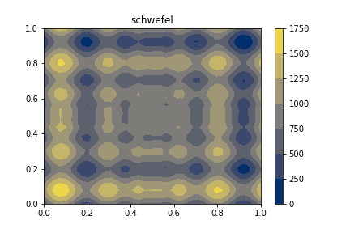
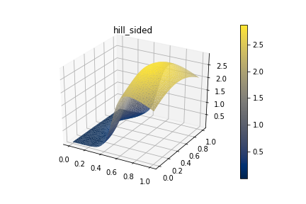
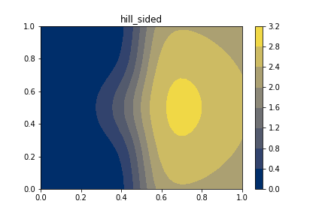
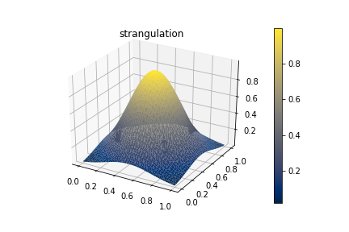
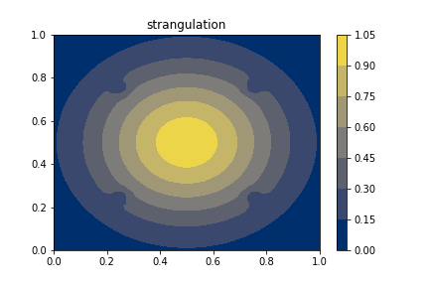
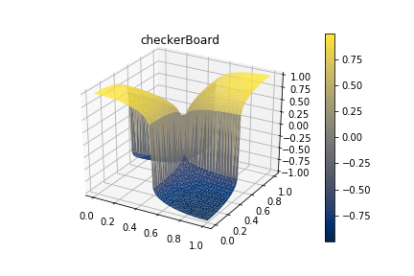
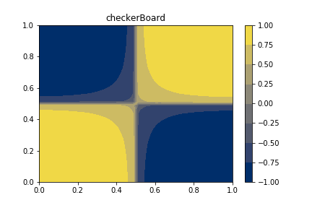
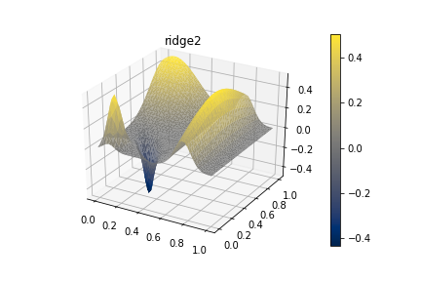
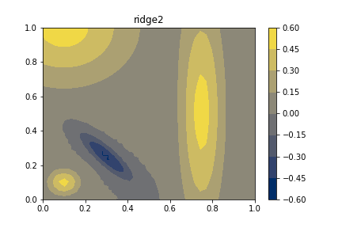
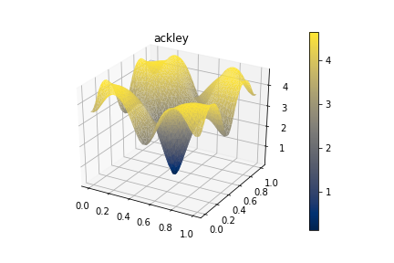
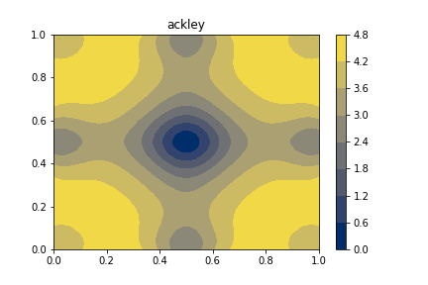
This Week
Next Week(s)
3/8/19
Topo+ML
Rudimentary analysis with foam data
Uncertain Topology
FlatPy - Function Library for analysis and test in python
A condensed collection of optimization functions used over several projects finally put into one place
Generating lots of data
Looking at nonparametric noise
Using intensity-based image segmentation to autotune clusters from survival count plots
Empty Region Graphs
Paper
Related works:
k-NN and ε-graphs
ERGs
Cone-based graphs
Technical Background
Topo+ML
Waiting on results from Jay
Uncertain Topology
Running more experiments
Empty Region Graphs
Probabilistic Yao Graphs
Performance results

Slide 5
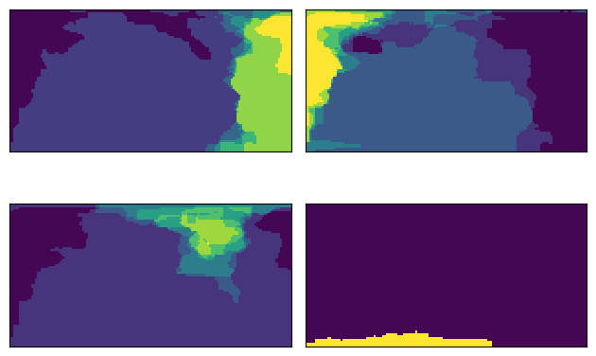
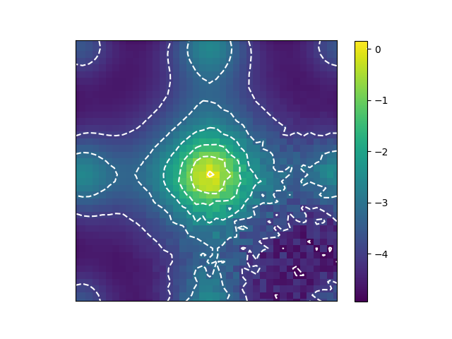
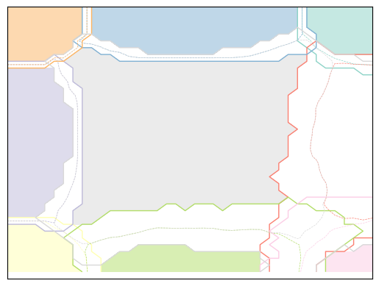
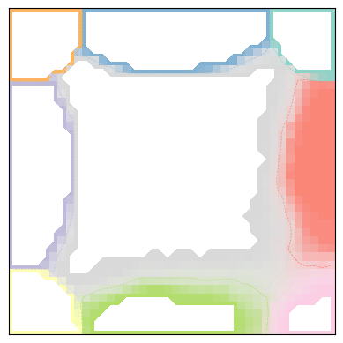
This Week
Next Week(s)
3/1/19
Topo+ML
Learning PyTorch
Learning about aluminum foam project
Uncertain Topology
Generating figures for Tushar
Editing paper
Running analysis on flow and temperature datasets (debugging required)
Optimizing workflow for analysis
Attempting to autotune selection of:
Persistence and # of clusters
Empty Region Graphs
Paper
Working on related
works section
NGLpy-CUDA
Porting exploratory
notebook to script
that can run a
larger volume of tests
Topo+ML
Waiting on some results from Jay
Try to look at the foam dataset
Uncertain Topology
Writing
Running more experiments with different noise models and making sense of real-world datasets
Empty Region Graphs
Writing algorithm/framework section
Running experiments and filling in text for that section
Temperature Ensemble
Max assignment prob. for 4 clusters
Ackley Function
Noise amplitude as a function of domain

Slide 6
This Week
Next Week(s)
2/22/19
Topo+ML
Working with Sam today
Empty Region Graphs
Samply
Online example using Google Cloud Platform
Changed API to be organized based on desired space:
ball, directional, subspace, hypercube
NGLpy-CUDA
Migrated Yao graph code to GPU
Improved testing and bug hunting
Thinking about how to make probabilistic edges for Yao graphs:
Proximity to point
Generate several different random cones and count number of times each edge shows up
Topo+ML
Waiting on some results from Jay
Empty Region Graphs
Continue writing
Gather some official experimental results evaluating these graphs
Do more with the probabilistic graphs
Migrate Θ-graphs to GPU (low priority)
Low pay-off
These won’t be much use for our applications, but it makes the software more complete

Slide 7
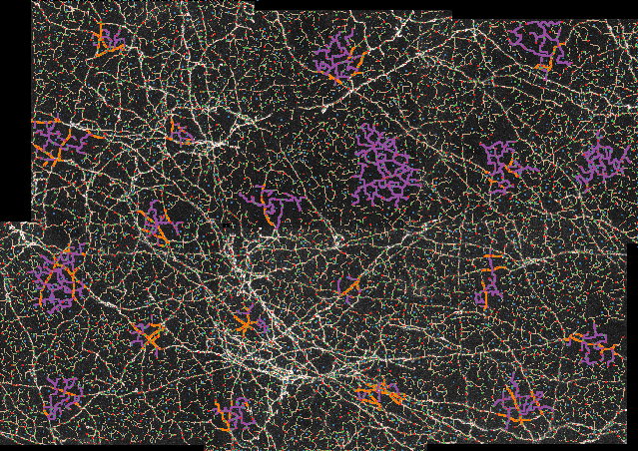
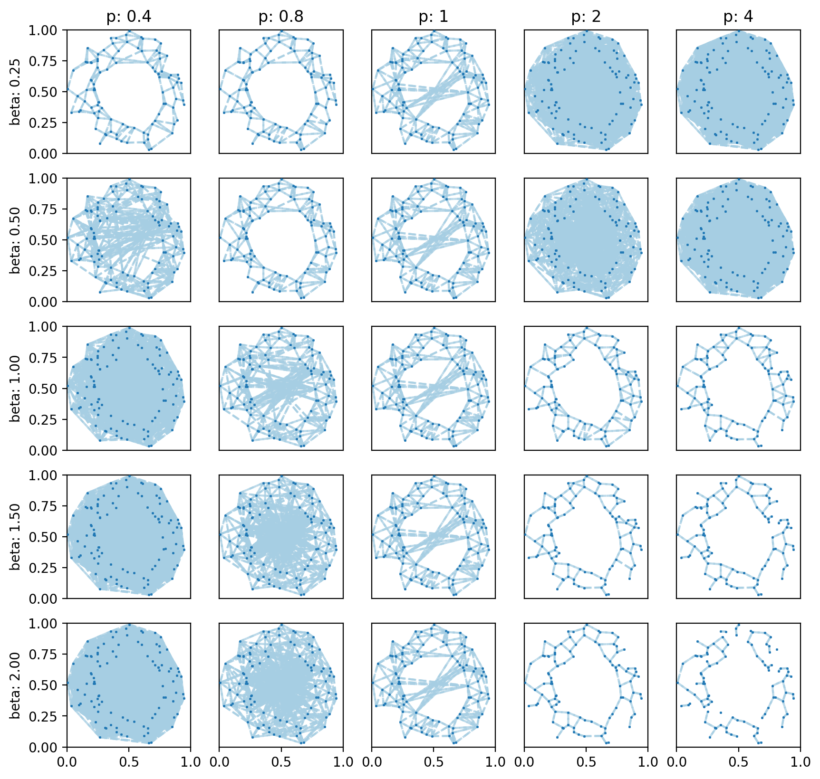
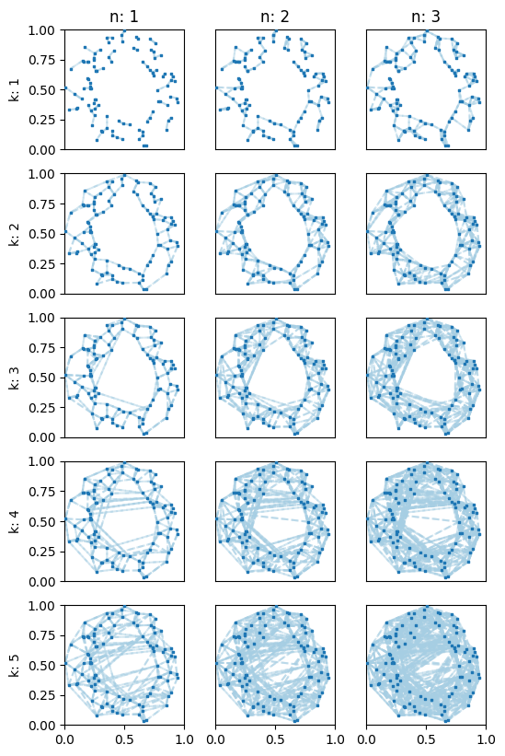
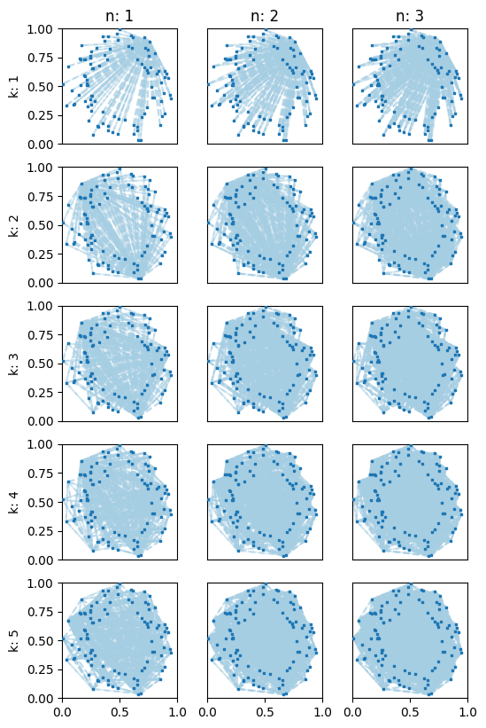
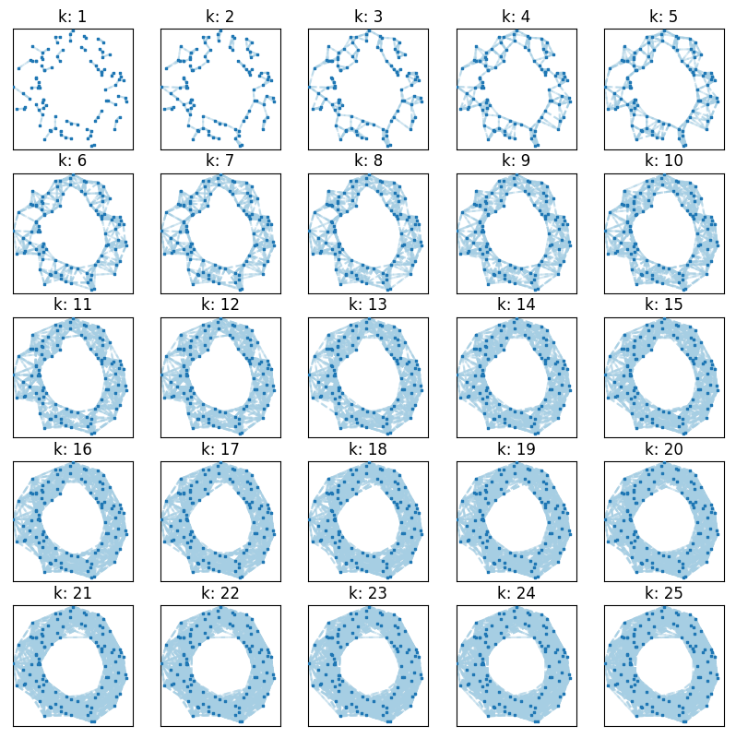
This Week
Next Week(s)
2/15/19
Topo+ML
Sampling from fully
labeled image using:
Box
CVT seed set +
k-ring of neighbors
Empty Region Graphs
n-dimension k-Θ & k-Yao Graphs by using a CVT constrained to the surface of the unit n-sphere
Paper skeleton on bitbucket
Organizing a bunch of code:
Samply - sampling library with SCVT
NGLpy-CUDA (metrics branch)
Jupyter nb w/ interactive widgets
New API: DistanceGraphs, ConeGraphs, EmptyRegionGraphs
Uncertain Toplogy
No meeting, just doing some writing
Topo+ML
Waiting on some results from Jay
Possibly encoding new features
Empty Region Graphs
Continue writing
Migrate cone-based graphs to GPU
Parallelize samply.CVTSampler
The metrics I designed don’t generalize well to high-dimensions
Approximated with other characteristics?
Is an analysis in 2D-3D good enough?
Other tests can be run in >3D
βp-Skeletons
k-Yao Graphs
k-Θ Graphs
kNN Graphs

Slide 8
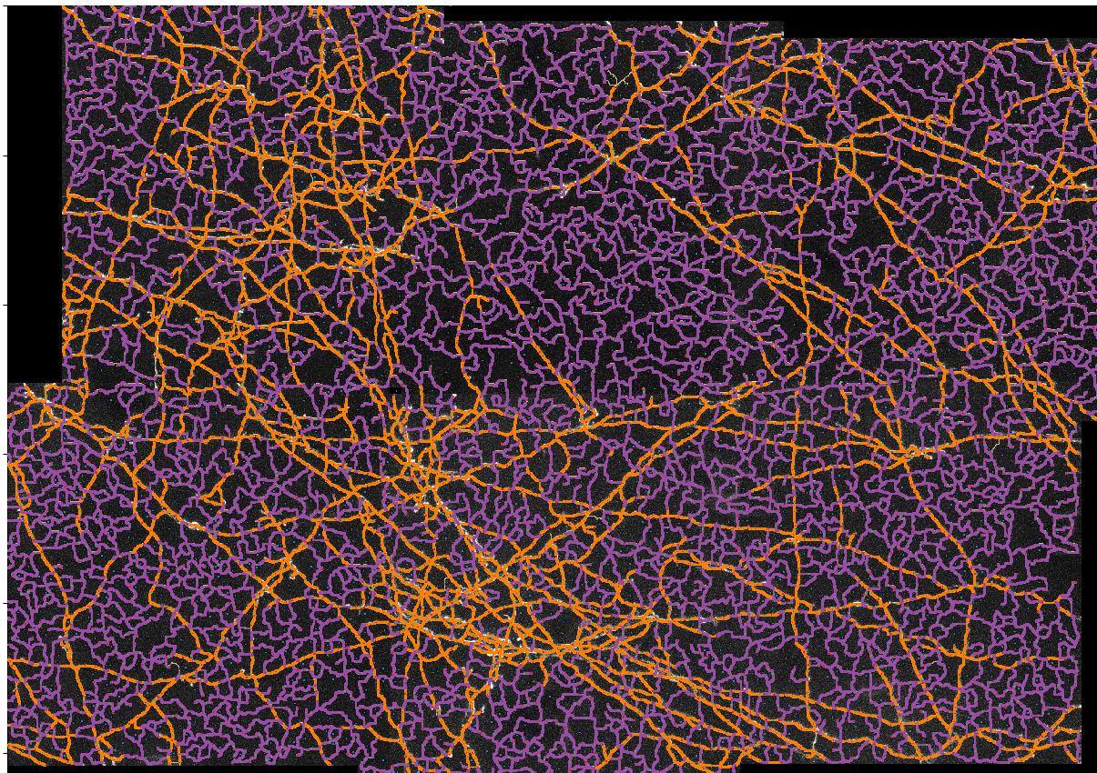
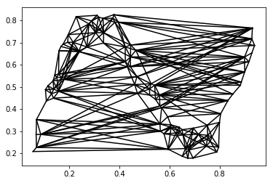
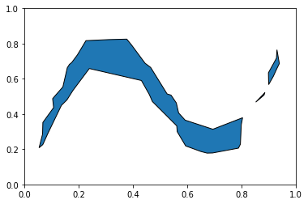
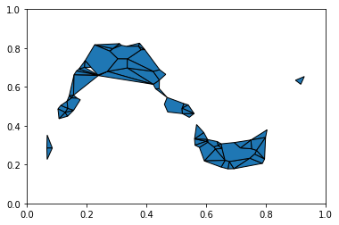
This Week
Next Week(s)
2/8/19
Topo+ML
Fully labeled 2D image:
Scripts for culling sample to box or space-filling design with k-ring of connected arcs (in progress)
Empty Region Graphs
2D Yao graphs for comparison with kNN, 1-skeleton of Delaunay triangulation, and β-skeletons
4 metrics for graph quality:
Minimize intersections
Minimize length of edges outside of α-hull
Minimze the average area of induced polygons
Maximize induced coverage of the α-shape
Topo+ML
Look at results with different samples
Uncertain Toplogy
Biweekly meeting with Bei and Tushar next week
Looking for real-world 2D ensemble data
Empty Region Graphs
Arbitrary dimension Θ-Graphs and Yao Graphs
Can we address any of these caveats:
2D only implementation
Need a carefully selected α value per dataset
Need to construct the polytopes induced by the edge set

Slide 9
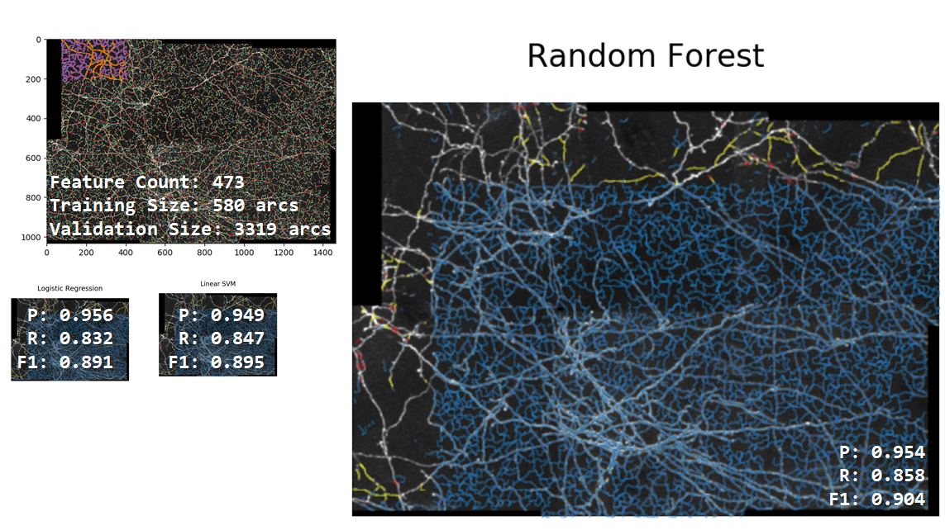
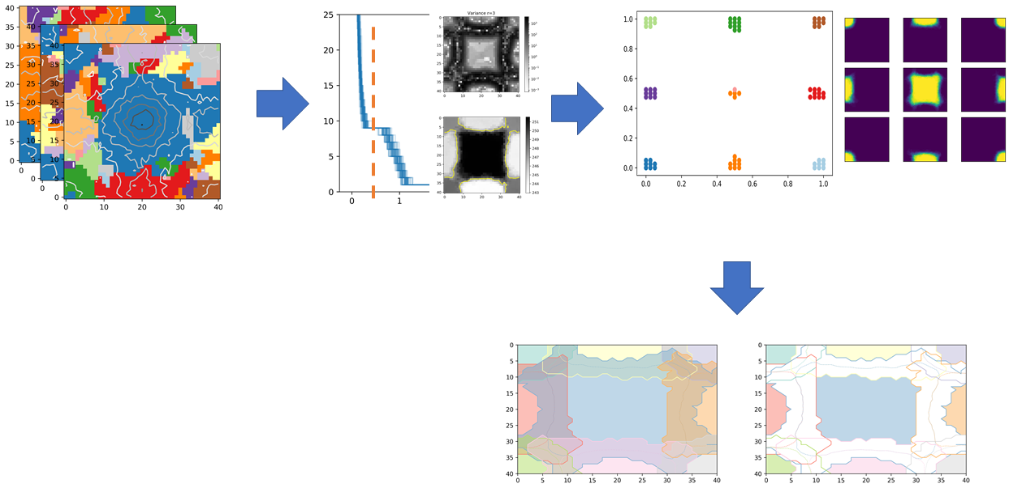
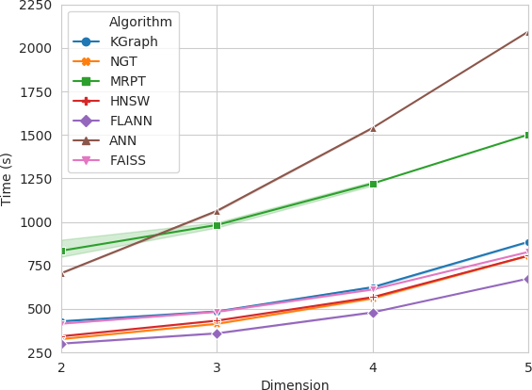
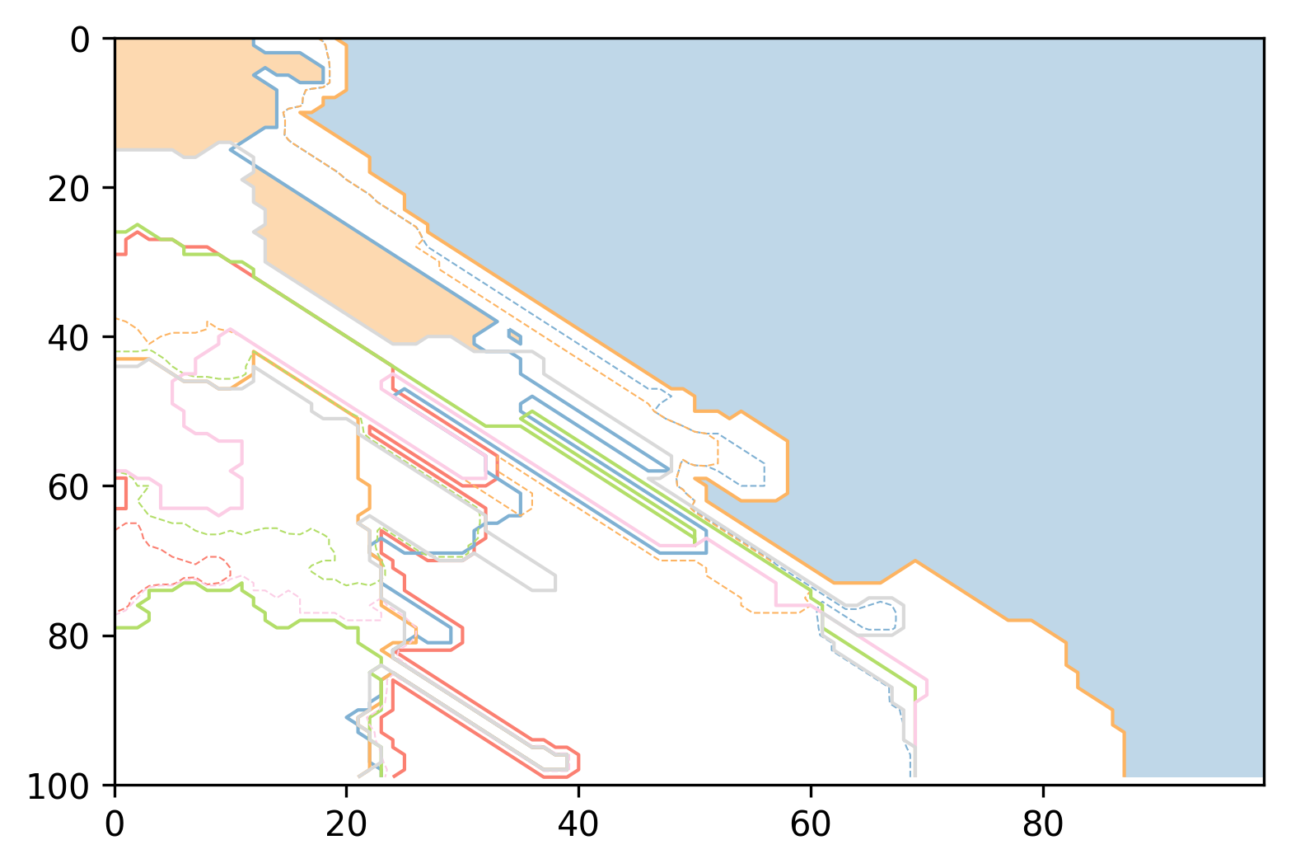
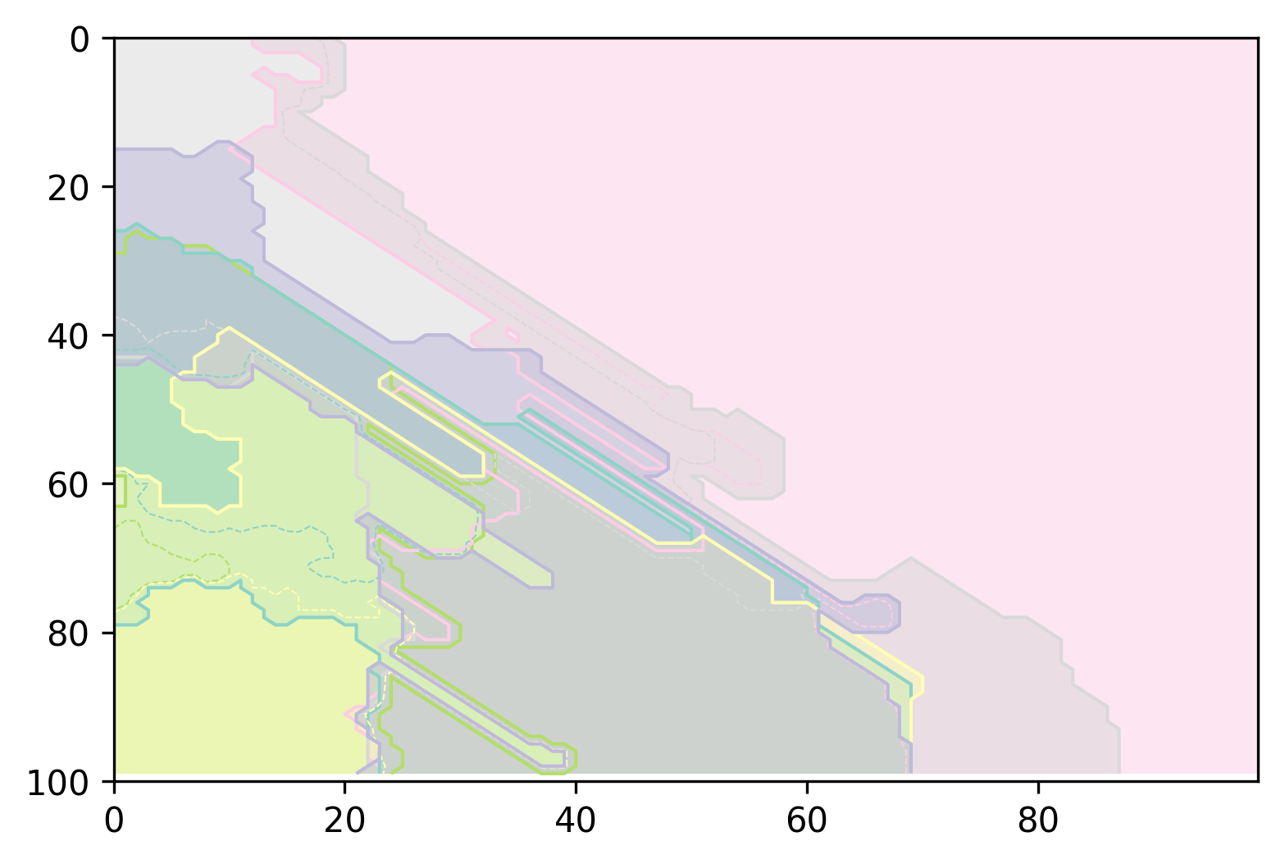
2/1/19
Neuron Tracing:
Pipeline for Uncertain Morse Complex:
More Reliable data for ANN Comparison:

Slide 10
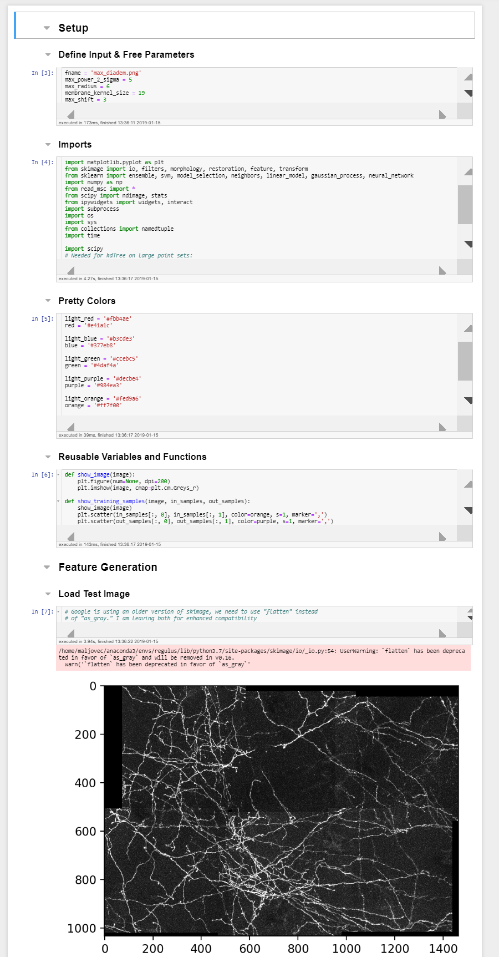
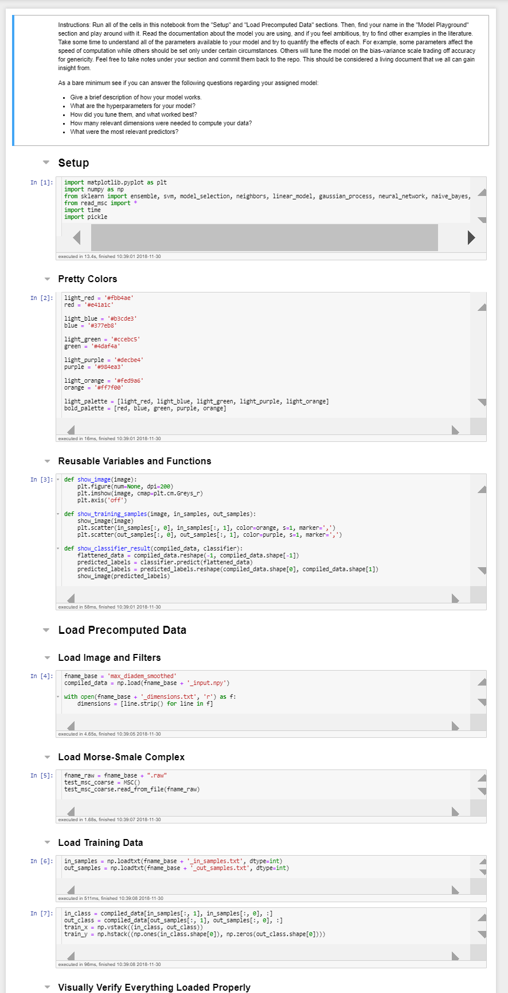
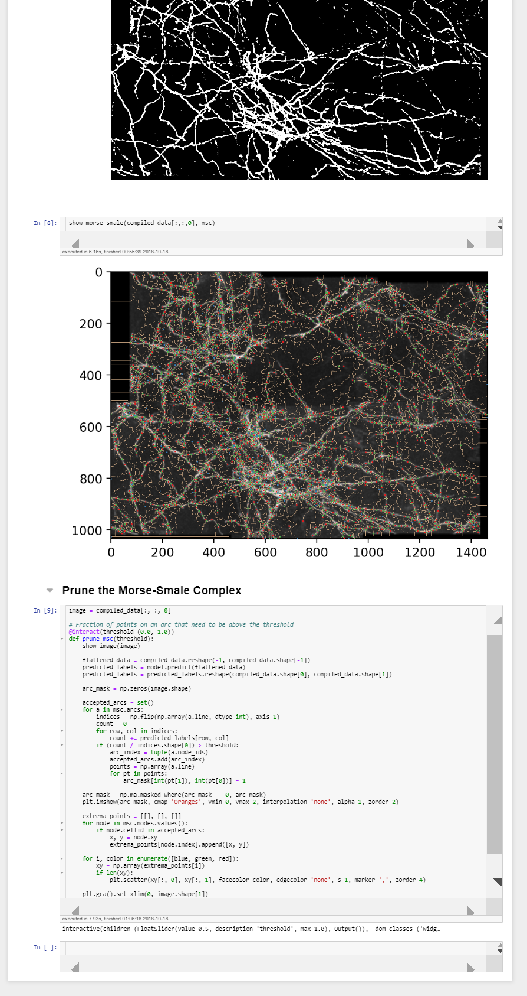
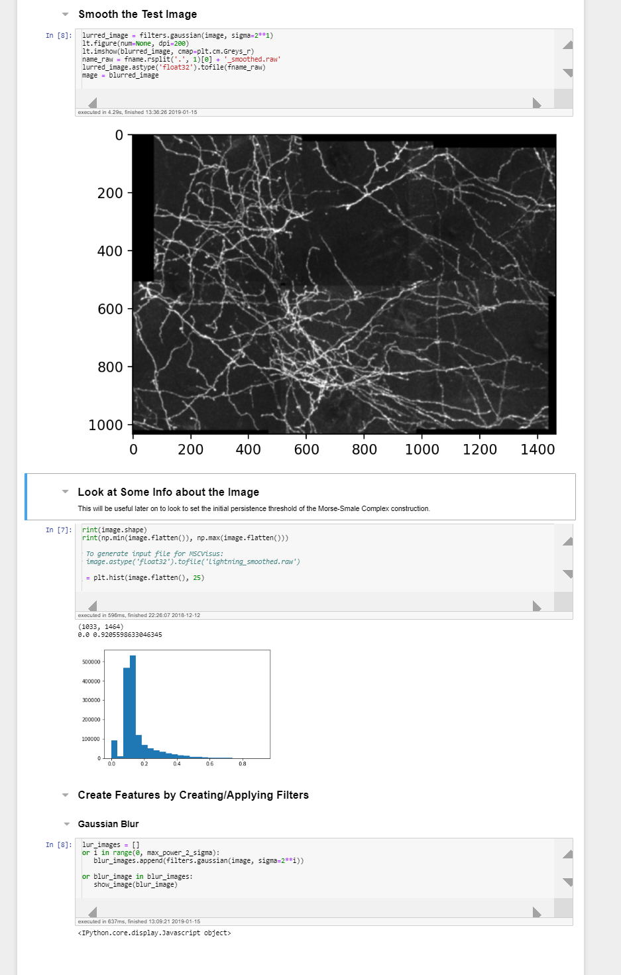
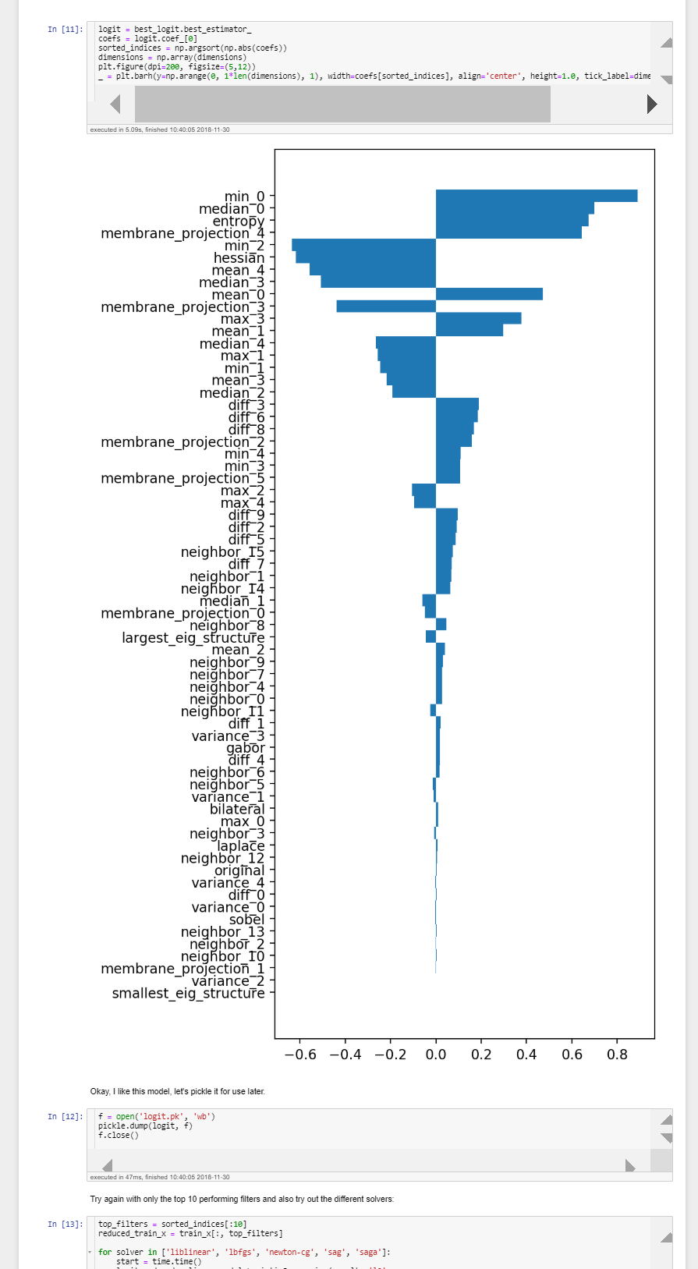
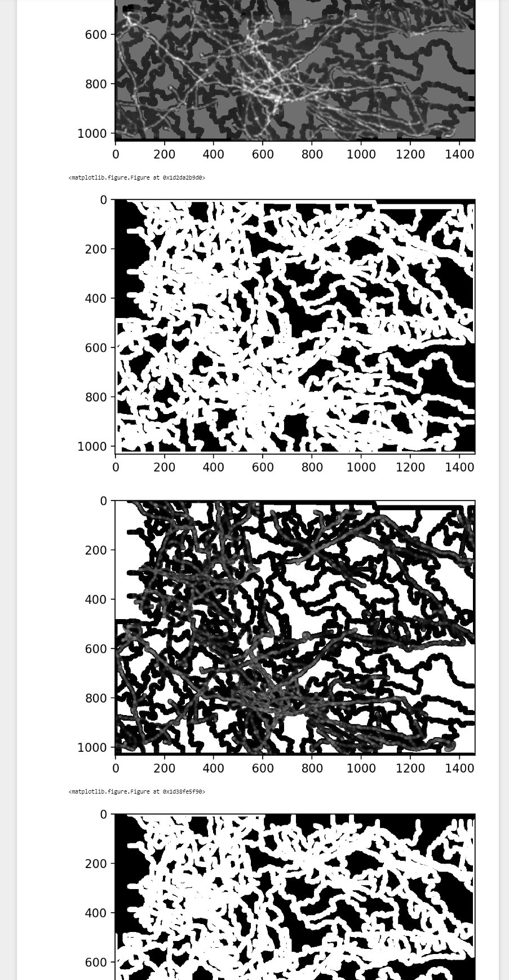
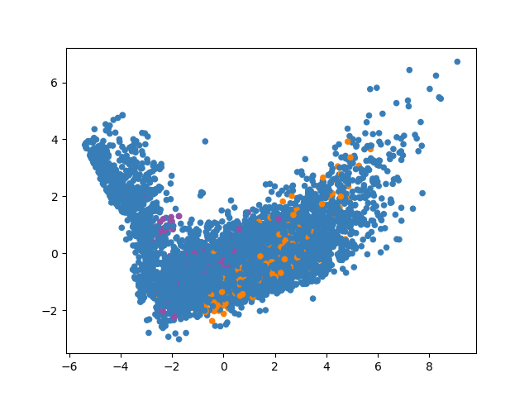
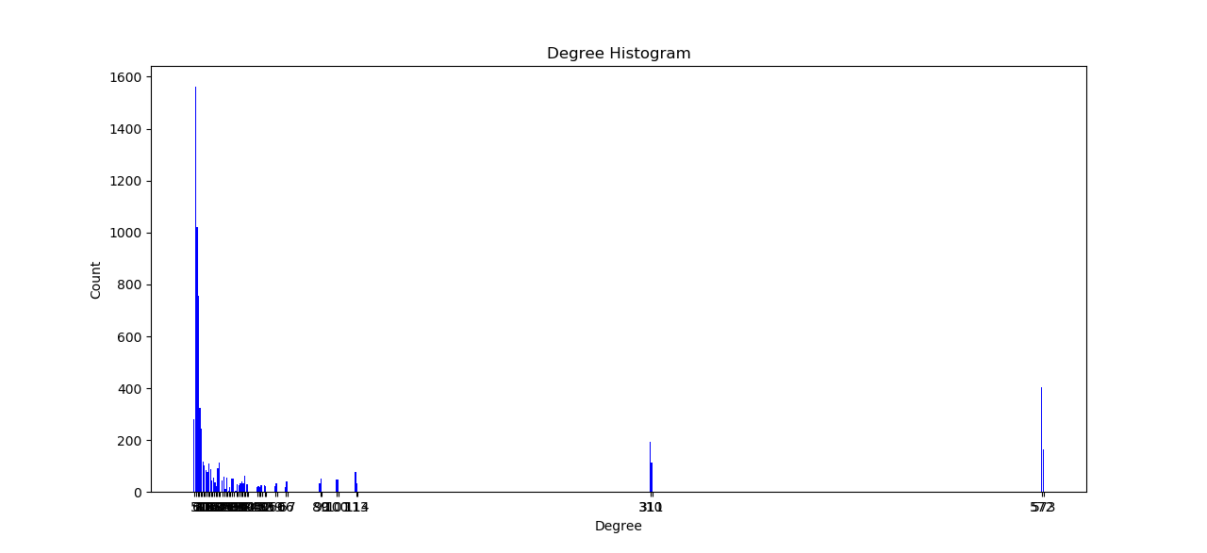
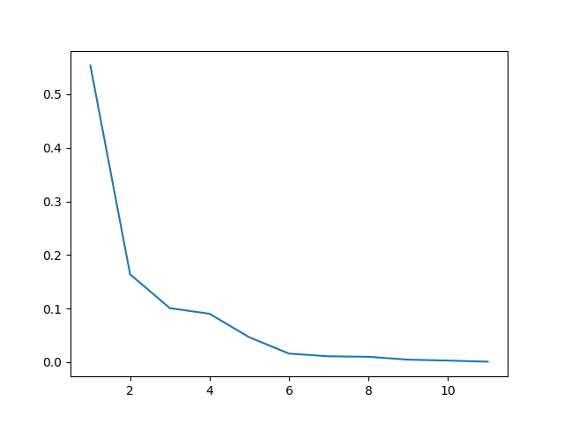





This Week
Next Week(s)
1/25/19
Topo+ML
Learning about GCNs
Collecting information about the primal and dual graphs of the MSC for graph discussion next week
New package:
Topo+ML
Meeting w/ Jay and Rushil on applicability of GCNs
Empty Region Graphs
Determine proper metrics for evaluation
Scalable Topology
Updated results in paper
Uncertain Toplogy
Meeting with Bei and Tushar Tuesday
∃ arcs connected to 573 other arcs

Slide 11









This Week
Next Week(s)
1/18/19
Topo+ML
Fixing manual selection for Sam’s demo
Massaging Attila’s code into a networkx graph and numpy arrays suitable as input for GraphSage
GPU-enabled Empty Region Graphs
Interfaces for:
FLANN - works
ANN - works
FAISS-GPU - works
NGT - works
MRPT - works
HNSW - broken
KGraph - broken
NSG - broken
Point distributions for testing
Uncertain Topology
Lots of plots:
Topo+ML
Understand Graph Neural Networks
GPU-enabled Empty Region Graphs
Write Introduction
Determine proper metrics for evaluation
Compile existing experiments and images into text
Scalable Topology
Anything need done here?
Regulus
Code for weighted linear models
Force-directed graphs?
Uncertain Toplogy
Meeting with Bei and Tushar

Slide 12

1/11/19 (unable to attend)
Listed in decreasing order of readiness/priority
Primary effort: Empty Region Graph study to include a subset of the following:
GPU algorithm of strict and relaxed graphs
A generalized formulation that allows for any symmetric shapes to be used for the empty region using a discretized version of the algorithm.
But limit the study to the effects of two parameters, β and p.
A k saturation study on the appropriate k for various graphs/dimensions/distributions
an extension of what was done for the HDTopology paper to different point distributions and using different versions of the ERG
Probabilistic graph formulation and examples of extracted topology
Can an ensemble of topologies reveal a “stable” persistence range?
The GPU algorithm should make the computation of “enough” realizations on moderate data sizes be feasible on commodity hardware
Applications of generic ERGs to potentially replace kNN:
Regression/Classification
Decision Boundary Analysis
Other suggestions welcome
Notes:
The paper should include several examples/studies carried out on analytic or well-understood datasets where we can evaluate the effects of the generalized parameter p and its combination with the existing beta parameter. It is my belief that for >95% of the cases we will want the standard p=2 & beta=1 formulation, but there exist cases where alternatives will be desirable. I intend to find and highlight those and I think it is important for the wider community to understand when they need to be aware of them.

Slide 13
1/11/19 (continued)
Supporting work:
Yarden: Regulus paper?
Zhimin: SpotSDC
Di: Possibly something with adaptive sampling?
Tushar: uncertain topology
Shusen/Timo/Di: Finishing scalable topology paper

Slide 14
This Week
Next Week(s)
12/28/18
ICSE
Regulus
ML
NGLPy
TopoPy
In-Depth Engineering
ICSE
Get d3.parcoords.js in jupyter
Fix hovering highlight
Regulus
Push new TopoPy interface
Adding sensitivity to the details view
Start write-up
TopoPy
Rewrite in pure python as an exercise in vectorizing
Attempt to parallelize
NGLPy
More KNN graph interfaces with NGLPy
Test interface with HDTopology

Slide 15
This Week
Next Week(s)
12/21/18
ICSE
Regulus
ML
NGLPy
TopoPy
In-Depth Engineering
ICSE
Get d3.parcoords.js in jupyter
Fix hovering highlight
Regulus
Push new TopoPy interface
Adding sensitivity to the details view
Start write-up
TopoPy
Rewrite in pure python as an exercise in vectorizing
Attempt to parallelize
NGLPy
More KNN graph interfaces with NGLPy
Test interface with HDTopology

Slide 16
This Week
Next Week(s)
12/14/18
ICSE
Higher-level API
2D Scatterplot projections
Adding tooltips
Axis labels on leftmost axis
Dimensional histograms
3D Boiler Tower representation linked to tooltip display
Regulus
[ ] A visual representation of stepwise fitness
[ ] Metrics to describe size/shape of partition
[ ] Model fitting with weighted points
NGLCu
Abstract
Setup tests
ICSE
Get d3.parcoords.js in jupyter
Fix hovering highlight
Regulus
Push new TopoPy interface
Adding sensitivity to the details view
Start write-up
TopoPy
Rewrite in pure python as an exercise in vectorizing
Attempt to parallelize
NGLPy
More KNN graph interfaces with NGLPy
Test interface with HDTopology

Slide 17


This Week
Next Week(s)
12/7/18
Scalable Topology:
Drastic improvements in NGLCu performance:
Switched set to unordered_set (Thanks Di)
Got FAISS-GPU and FLANN-OMP working
FLANN-OMP offers good scalability/stability
Setting up on shared SCI resources
Writing some background for topology/geometry
Performing k saturation tests:
At what value of k do I stop getting new edges for my relaxed, symmetric Gabriel graph?
Computing statistics on the graph
Miscellaneous
SpotSDC paper
Tushar: Uncertain MC
Writing papers:
Scalable Topology
SpotSDC
Uncertainty paper w/ Tushar (unlikely to finish)
Continue with graph experiments
Talk to Sean/Phil from ICSE
Continue discussions with Yarden on Regulus
Possibly start trying out a lot of what we have been talking about
KNN queries vs. KNN graph
Notes:
Figures are for 2D Symmetric, Relaxed Gabriel Graph with 1 million points and k=30

Slide 18



Switching from std::set to std::unordered_set
^ ANN vs. FLANN v

Slide 19
The Past Few Weeks
Next Week(s)
11/30/18
Met w/ Tushar regarding uncertain topology
ICSE
Met with Sean & created new feature list
Regulus
Discussed model fitting to stable manifolds w/ Yarden
ML
Trello board
Slide deck for status report
Packaging code into proper package (ongoing)
Generalizing image filters to 3D
NGLCu & Large-Scale High-Dim Viz
Building the whole pipeline
Validation testing
Writing and testing interfaces with:
FLANN
FAISS
GPU-FAISS
ICSE
Hammering away at issue list
NGLCu
I really need to start writing this stuff down
More validation testing
Start running tests for:
Varying β
Varying p
Varying sampling strategy
Compare relaxed to unrelaxed
Compare mutual to symmetric relaxed graph
Among these tests compute:
Ability to recover known topology
Statistics of edge lengths
Statistics of connectivity
Longer-term problems:
Creating mutual relaxed ERG on the GPU
Fixing the strict algorithm to adaptively batch queries onto the GPU

Slide 20
11/23/18
Thanksgiving (no meeting)

Slide 21
This Week
Next Week(s)
11/16/18
ICSE
Met with Sean & created new feature list
Regulus
[ ] A visual representation of stepwise fitness
[ ] Metrics to describe size/shape of partition
ML
Getting organized:
✔ Trello board
✔ Slide deck for current state of affairs
[ ] Packaging code into proper python package
NGLCu & Large-Scale High-Dim Viz
[ ] Building the whole pipeline
[ ] Validation testing
[ ] Writing and testing interfaces with:
✔ FLANN
✔ FAISS
[ ] GPU-FAISS
[ ] Full pipeline stress test
ICSE
Hammering away at issue list
NGLCu
I really need to start writing this stuff down
More validation testing
Start running tests for:
Varying β
Varying p
Varying sampling strategy
Compare relaxed to unrelaxed
Compare mutual to symmetric relaxed graph
Among these tests compute:
Ability to recover known topology
Statistics of edge lengths
Statistics of connectivity
Longer-term problems:
Creating mutual relaxed ERG on the GPU
Fixing the strict algorithm to adaptively batch queries onto the GPU

Slide 22



This Week
Next Week(s)
11/9/18
ICSE
TST Meeting - tool seemed well-received
Regulus
Pushing new TopoPy interface
Experimenting with Stepwise Fitness
Discussion - How to represent shape and size?
ML
Worked with Sam (he did most of the work):
Automating the selection of training data
NGLCu
NGLCu as an optional dependency in HDTopology
Git submodule, YMMV
ExtremumGraph/ERG stress testing:
ICSE
Post-mortem on meetings
Regulus
A visual representation of stepwise fitness
Metrics to describe size/shape of partition
NGLCu
More testing
Longer-term problems:
Creating mutual relaxed ERG on the GPU
Fixing the strict algorithm to adaptively batch queries onto the GPU
Extrapolating to actual problem size on my own desktop machine would take ~2 days of non-stop computation
Wall Time (in minutes)
800
600
400
200
0
1 Million
10 Million
25 Million
Why?
Faster knn queries
C++ slowdown for computing additional indices
Python performance
>
C++ performance
2 3 4 5
Dimensionality

Slide 23
This Week
Next Week(s)
11/2/18
ICSE
Sean, Phil, & Ben: excited to try out the tool
TST meeting preparation
NGLPy
Validating against Carlos’ code
Discrepancies due to symmetric vs. mutual ERG
(OR) (AND)
How to compute a streaming, mutual ERG?
Post-processing step
Implies all edges are stored in memory somewhere (100M x 250 ~100GB)
Naively: O(nk²)
Or somehow order nearby points and ensure they are part of the same batch
Hard to guarantee this is even possible
Re-run the same queries multiple times
I want to generate a histogram of this to see how many times each index ends up being queried in practice
NGLPy
Consider other ways of getting at the mutual ERG
Write a more adaptive method for the batch size of the strict ERG method.
The version I have now is:
Leaves a lot of free memory per GPU call
Wastes a lot of time repeating knn queries
pr is valid
∴ pq is invalid
qr is invalid
∴ qp is valid
rq is valid
q
p
r

Slide 24



This Week
Next Week(s)
10/26/18
NGLPy
Excising Python portions
ANN interface (complete)
FAISS interface (started)
Some optimization 90s → <15s for 1M points in 2D
ICSE
UI improvements
ICSE
Get d3.parcoords.js in jupyter
Regulus
Push new TopoPy interface
Adding sensitivity to the details view
NGLPy
Compare performance with ANN vs. FAISS
Fix chunking problem in new C implementation (needed for large-scale data that doesn’t fit on GPU)
Performance analysis breakdown on C code (similar to last week)

Slide 25


This Week
Next Week(s)
10/19/18
ML
More modular notebooks
Example analysis on logistic regression
Large-Scale High-Dim Vis (NGLPy)
Python 2.7 support for NGLPy
C++ example working with hdtopology
Python example struggling with overloads
CMake for topoprocessing:
How to include hdtopology as a library and include directory
In-Depth Engineering
Finalizing proposal
ICSE
Fixed highlight on hover
Large-Scale High-Dim Vis (NGLPy)
Putting everything together on a lager run
NGLPy
Improve performance on strict beta skeletons
More KNN graph interfaces with NGLPy
Write, write, write
Regulus
Push new TopoPy interface
Adding sensitivity to the details view
Start write-up

Slide 26
This Week
Next Week(s)
10/5/18
ICSE
Improved dashboard with some new bells and whistles
Regulus
Digging up Principal Hessian cutting code
ML
We have some new images to test
NGLPy
5D examples of ANN-benchmarks
Checkpointing and caching flags for storing partial results
Coupling to NDDAV/HDTopology
Probabilistic graphs and different samplers
When working with numpy check array order
New bugs to squash:
Undiagnosed issue with chunking
TopoPy
Using clustering on uncertain topology
Some writing with Steve
ICSE
Get d3.parcoords.js in jupyter
Regulus
Push new TopoPy interface
Adding sensitivity to the details view
TopoPy
Rewrite in pure python as an exercise in vectorizing
Attempt to parallelize
NGLPy
More KNN graph interfaces with NGLPy
Start writing about probabilistic graphs

Slide 27







This Week
Next Week(s)
9/28/18
ICSE
Creating a d3-based ipywidget
Attempting to use d3.parcoords in jupyter
ML
Try again to get everyone tuning models
NGLPy
Improvements to GPU code:
5D, 10M, K=300 on desktop 6h → <2h
Updating branches to interface with new API
Some examples of using probabilistic graphs to compute a Morse complex
(100 realizations each, N= # of points)
ICSE
Keep working on d3 in jupyter
Regulus
Push new TopoPy interface
Adding sensitivity to the details view
Adding Principal Hessian Directions code
TopoPy
Rewrite in pure python as an exercise in vectorizing
Attempt to parallelize
NGLPy
Couple other KNN graphs with NGLPy
Add lower dimensional examples to ann-bencmarks
N=50
N=100
N=1000

Slide 28



This Week
Next Week(s)
9/21/18
NGLPy on GPU
Redesigned interface to make graphs iterable:
for edge in graph:
print(edge)
Squashing bugs dealing with chunking the problem into sub-problems, still need to optimize
Trying to automate the query_size parameter
Tested 5D, 10M, K=300 on desktop (6h, but this can be improved dramatically, I think...)
Implemented SearchIndex class that allows plugging in different KNN implementations
relaxed ERG (much faster)
ML
Pictures →
ICSE
Rewriting tool, make sure I get paid...
Regulus
Push new TopoPy interface (delayed)
Adding sensitivity to the details view
TopoPy
Rewrite in pure python as an exercise in vectorizing
Attempt to parallelize
NGLPy
Optimize: put index remapping on GPU
Benchmark other KNN graphs coupled with NGLPy

Slide 29





This Week
Next Week(s)
9/14/18
TopoPy
Fixed bug from last week & improved testing
Tushar/Di/Bei mtg re: uncertain Morse Complex
didn’t go as expected...
NGLPy
Formulated a probabilistic neighborhood graph w/ few tunable parameters with Di
Implemented and tested on a small example
Regulus
Example sensitivity widget
Added stepwise regression fitness attribute, but still having factory issues
ML
Notebook for the group to build on
ICSE
No word
Keep working
Regulus
Push new TopoPy interface
Adding sensitivity to the details view
TopoPy
Rewrite in pure python as an exercise in vectorizing
Attempt to parallelize
NGLPy
Make compatible with multiple ANN libs

Slide 30
9/7/18
This Week
Next Week(s)
TopoPy - MorseComplex as a first-class citizen
Building MorseSmaleComplex from 2 MorseComplex objects
Improving testing & API
Improvements from Pavol
Regulus
Fought with development set up for Jupyter lab
Ipywidgets tutorials
Lots of discusssion with Yarden
Working on first widget
TopoPy
Rewrite as pure python as an exercise
Attempt to parallelize
Meeting with Tushar, Di, and Bei regarding the uncertain Morse Complex
Regulus
Have example widgets
Start checking things off the backlog
ICSE
Moving to ipywidgets
Ask again about new data
NGLPy
Run example of 1 billion points
Make compatible with multiple ANN libs

Slide 31



8/31/18
Vis Seminar
Made some animations to walkthrough approximate Morse complex algorithm
Need to schedule follow-up meeting with Tushar
iPyRegulus
Still learning ipywidgets
Lots of discussion with Yarden
TopoPy/nglPy
Discussion with Di & Yarden led to simplified algorithm for Gabriel graph from KNN
ICSE
Sean & Phil are happy with dashboard so far
Complete redesign needed to use ipywidgets

Slide 32
8/24/18
Thinking about streaming NGL and Morse Complex
NGL: K-nn graph to be pruned is directed, non-symmetric
MC: How to extract cell boundaries for estimating saddle/persistence
Maintenance on nglpy, nglpy-cuda, topopy repos:
cookie-cutter for best practices on github repos: - [WIP]
Consistent and sensible APIs needed
ICSE
Minor improvements to custom dashboard - ongoing
Need to meet with Sean
Resources provisioned
Vis Seminar - next week
CI - Travis
Code Coverage - Coveralls
Dependency updates - Pyup
Documentation - ReadTheDocs - [sparse]
Unit Testing - PyTest & tox - [not using]
Deployment - PyPI - [nglpy-cuda not deployed]

Slide 33
8/10/18
Collaboration with Sean Smith
Demo of simple PCP dashboard for Sean, he seems happy
now we can start to build something more robust
Met with HS student (Atreya Rawat) working with Sean
Neighborhood Graphs
NMSLib-HNSW: n=1M, d=10, k=500 results:
parameters tuned down: 8 minutes
parameters tuned up: 1 hour
**Major caveat: Yet to measure accuracy difference on test data
FAISS: working on the GPU (4-5 minutes for above case)
Parameter nprobe which is supposed to trade off speed/accuracy
Could not get nprobe to give me different results
Reading - Slightly better understanding of some of these algorithms
Working on packaging nglpy_cuda into a pip-installable package
Failed on n=10M
Does not appear to be scalable

Slide 34
8/3/18
Mid-week wedding threw me off
Worked on dataset for Sean
Querying, displaying, and interacting with data from his surrogate model
Pushed NMSLIB to its limit, 100 Million points in 10D:
Turned up all parameters to 11, and it never even built the index (4 days):
0% 10 20 30 40 50 60 70 80 90 100%
|----|----|----|----|----|----|----|----|----|----|
*****
Trying again with parameters at lowest settings, after 2 hours:
0% 10 20 30 40 50 60 70 80 90 100%
|----|----|----|----|----|----|----|----|----|----|
**********************
Wrote script to test faiss with GPU, but waiting for above example

Slide 35




This Week
Next Week(s)
10/12/18
ICSE
Updates to selection and hovering
Regulus
Reviewing abstract and paper skeleton with Di on adaptive sampling
ML
Optimizing picking and display of MSC
NGLPy
Squashing some new bugs I introduced
Writing paper skeleton
TopoPy
Using clustering on uncertain topology
In-Depth Engineering
Adding section to SBIR/STTR proposal
Putting together some images
ICSE
Valerio: Do you need anything specific for the November meeting? Ask same question of Smiths
Get d3.parcoords.js in jupyter
Regulus
Push new TopoPy interface
Start write-up
TopoPy
Rewrite in pure python as an exercise in vectorizing
Attempt to parallelize
NGLPy
More KNN graph interfaces with NGLPy
Test interface with HDTopology

Slide 36
7/27/18
I want a fast approximate nearest neighbor (ANN) algorithm for building approximate topology in high dimensions:
Found library to benchmark ANN algorithms
Added hdidx, faiss, and annoy to this benchmark
Found a better library to benchmark ANN algorithms
Winner seems to be an algorithm called Hierarchical Navigable Small World
Fastest and most accurate implementation: NMSlib
Benchmark was not representative of data we explore, so wrote some of my own samplers into the benchmark and testing them
Met with Sean Smith Monday
Sean is out for this and much of next week
Exploring using plot.ly’s dash for prototyping something he can use quickly so we can get on to more interesting visualizations

Slide 37
7/20/18
Meeting with Sean Smith (CHE), Phil Smith (CHE), Yarden, and Valerio on visualizing high-dimensional simulation data from PSAAP project
Got some data from Sean yesterday going to try to do a quick prototype of PCP to understand what he is wanting to do with this data
Several discussions with Yarden to discuss forward direction of Regulus
Worked on trying to write pip installable python package for cuda version of ngl
not quite ready yet

Slide 38
7/13/18
Met Sean Smith from CHE Department:
Simulation:
10-20 inputs, up to 200 responses
Very sparse data: 20 simulations used to build surrogate (~$20K per sim.)
Inverse problem
Current research:
Generating and evaluating surrogate with sparse data
Would like to perform MCMC, but does not believe they can do it correctly, so they are looking for a conformal mapping of the input space in order to generate a transformed input space that is joint normal - does anyone know about Liouville’s theorem?
Currently, employing parallel coordinates and box-whisker plots to visualize
I have plots (see next slide)

Slide 39
7/6/18
Visiting family, slow week
Catching up on reading about sampling high-dimensional spaces
Thanks Duong and Sam for pointers
Setting up demos of high-dimensional visualization for Sean Smith in Chemical Engineering next week

Slide 40






6/29/18
N=10,000
N=100,000
N=1,000,000
NGL performance tests
Preliminary testing different KNN implementations:
ANN
SK-Learn
FLANN
Visualizing 2D results in browser
Python package for different sampling strategies:
BallSampler
DirectionalSampler
SubspaceSampler
Reading about more types of sampling:
Halton Sequences
time
Dim
D=[2,7]
*D=7 does not have a full 10 trials
Notes:
https://arxiv.org/pdf/1712.06028.pdf

Slide 41
6/22/18

Slide 42




6/15/18
NGL
Excised ANN computation for more faithful timing comparisons and ability to use more contemporary NN searches
Test set of a one million points:
OMP (4 HW threads)
version has some extra overhead (update NxK matrix and save to edge list afterward)
Eclipses base algorithm around 9D with k=300
GPU (GeForce GTX 980 Ti)
Two versions: one with a discrete reference shape
Allows for arbitrary empty region shape
Promising results on 2D-4D
error on >4D, seems due to arbitrary timeout since I also use this GPU for display
2D k=100
3D k=100
4D k=100
5D k=200
6D k=200
7D k=300
8D k=300
9D k=300
10D k=300

Slide 43
5/24/18
Nglpy:
Looking into numba for JIT compiling python code
Still slower than native C++ code
Parallelism mode is “experimental” and breaks

Slide 44

5/11/18
Wrote two versions of OpenMP for NGL:
1: Parallelizes the inner loop, but removes a short circuit break condition and incurs more overhead (slower)
2: Parallelizes the outer loop, but may be suffering from unwanted synchronization from one of the function calls inside?
Still investigating
shown using
8 threads on 4 cores
NGL on 1 million random points
Working on a vectorized pure python version
Possibly use something like cudarray, cupy, or numba as a drop-in replacement for numpy
Time (s)
Dimension

Slide 45
5/4/18
Generating some data for Di:
Sampling hyperparameters of neural networks for CIFAR-10 dataset
Taking a second look at the ngl library code:
Can this be parallelized?
For each candidate edge (starting from a knn graph):
Compute a discrete ERG template (see below)
Project all points onto edge and compare minimum value in template to height of point from edge (can discard projected values < 0 or > 1)
If any point is less than the minimum value at that discrete value reject the edge

Slide 46
4/27/18
No real good ideas
Reading/literature searching:
Barrier Trees:
Saddles and Barrier in Landscapes of Generalized Search Operators
Visualization of Barrier Tree Sequences
Barrier Trees of Degenerate Landscapes
Visualizing the Loss Landscape of Neural Networks
uses projections on 2D to evaluate convexity around local minimizers of the loss function.
Dimensionality reduction for problems with functional relationship:
Efficient Dimension Reduction for Multivariate Response Data
A new estimator for efficient dimension reduction in regression

Slide 47
4/20/18
Generating data for topological analysis:
Small neural networks where weights (~40 parameters) are randomly initialized (using mxnet instead of tensorflow)
Goals:
How frequently do local minima appear in the loss function landscape?
Are these basins of similar shape and depth?
Di and I also discussed the landscape of hyperparameters:
Learning rate, momentum, alpha, beta, gamma, dropout
Less clear how to analyze this...

Slide 48

4/6/18
We made a baby…
I have no idea what I am doing…
Resuming work next week
Lucas
7 lbs 8 oz
20“
3/30/2018 12:13pm

Slide 49
3/23/18
Debugging combustion dataset:
~5000 points represent a single location in domain space
Good work, Di!
Collecting datasets for regulus analysis
Analytic functions for testing
PNNL data, some older INL data
Discussions with Yarden and Di
Submitted abstract for interactive resampling of n-dimensional Morse-Smale complex

Slide 50
3/16/18
Topopy:
Removing flat extrema from appearing in the hierarchy
Disabling broken check for single connected component (use instead a flag to ensure it if needed)
Reducing warning messages
Debugging bug with case from Yarden (loop in hierarchy)
Paper:
Working with Di on fleshing out details for resampling MSC
Discussion today

Slide 51
3/9/18
Some additional checks and features for topopy:
Ensuring data is a single connected component
Testing for range space and domain space duplicates
Building collection of linear models for each Morse-Smale cell across all persistence levels
Evaluate the space of models to determine if there is enough diversity to warrant use of Morse-Smale complex
Ensemble models for reading group
Next week:
start working more on writing
Syncing with Di and Yarden

Slide 52
3/2/18
Iterating with Yarden and Di on using Morse-Smale complex for high-dimensional nuclear data
topopy
PEP8 standards
unit testing - 90% code coverage
Setting up continuous integration with https://travis-ci.org/

Slide 53
2/16/18
Working with Di a lot, looking into Sankey diagram visualization of n-dimensional Morse-Smale complex as alternative to dendrogram
Hoping to give a clearer picture of crystal size than colormap
Literature survey of in-situ resampling experiments guided by visualization
Abstract, Introduction, and list of related works for paper
Notes:
http://www.neatorama.com/2017/05/13/Make-Sankey-Diagrams-with-Sankeymatic/

Slide 54
2/9/18
Iterating with Di on paper for resampling the Morse-Smale complex in high dimensions
Playing catch-up here: hoping to have Introduction by end of day
Test driving Regulus
Minor tweak to topopy to expose the saddle points
Some progress on efficiency of decision boudary analysis, but still testing...

Slide 55
2/2/18
Dissertation writing
Catching up on ML coursework
Back to Decision boundary analysis:
Performance issues for 12D test set:
extracting boundary samples (43min -> ~10 min)
computing analytic gradients (?? min)
clustering (?? min)
Need to test the extracted set with DataExplorerHD
Talking with Di on resampling high-dimensional Morse-Smale complex
In
Progress
Notes:
PNNL

Slide 56
1/26/18
Two packages published to PyPI:
nglpy 0.0.1 (pip install nglpy)
topopy 0.0.1 (pip install topopy)
Thanks to Di for help in debugging normalization error
ML Seminar:
Weeks 2-3: Multivariate linear & logistic regression w/ regularization

Slide 57
1/19/18
Thanks Amy (3/2/15 - dag email):
Harms: There is a problem (state the problem)
Significance: the problem is serious enough to warrant attention (motivation)
Inherency: The status quo is not solving the problem. (background)
Topicality: our solution to the problem will solve the problem (approach, algorithm)
Solvency: our changes are significant enough, support quantitatively as well as qualitatively (results)
Read about Theory Section of Policy debate on Wikipedia
http://en.wikipedia.org/wiki/Policy_debate
pyerg & topopy on test.pypi
Di: we should be able to test this today
Helping Diego address reviewer comments for Multi-Unit PRA article
Abstract for multi-dimensional decision boundary analysis (WIP):
Visualizing Multidimensional Decision Boundaries for Risk Analysis
Evaluating the efficacy of classification in anything higher than three dimensions is inherently non-visual requiring statistical validation thus decreasing our intuition of the shape and complexity of the model we are using. High-dimensional data is ubiquitous and dominates most contexts where classification is used. Most methods used for validation describe a classifier's global behavior. We present a strategy of analysis that focuses on analyzing and describing the decision boundary, the hypersurface separating two different classifications of the input data. We present our findings in the context of analyzing risk for nuclear power plants.
Notes:
Glad it was helpful ~Amy

Slide 58
1/5/18
Organizing codebase:
pyerg - Empty Region Graphs (simple python wrapper for NGL)
topopy - Computes Morse-Smale complexes, merge trees, and contour trees using pyerg (no external C++ dependencies)
Preparing for submission to PyPI:
Uploaded pyerg on test.pypi.org
Created Docker instance of new machine to test
pip install --index-url https://test.pypi.org/simple/ pyerg
Note: run swig before uploading code to create one line install
TODO: work on better names, work out minor kinks in compilation/packaging
Should be available this time next week
✔
✔

Slide 59
12/22/17

Slide 60
12/15/17
Testing this stack:
Golden-Layout
presentation and window management
Thanks to Shusen for pointer
D3
expressive and interactive visualization
React
Reusable components
State handling
Flask
Data manipulation/routing
Get to keep the Python ecosystem

Slide 61

12/8/17
Testing different cluster sizes on DBA still less accurate than PCA and LDA
This is the wrong analysis to be testing efficacy of methodology
I would like to interact with this data in browser, but still prototyping
Any help pulling python backend analysis into js dashboard for MCV?
Someone is using HDViz/MSC for visualizing data on gifted children
Nuclear Station Blackout Data
Classification Error
Reduced Space Dimensionality

Slide 62

12/1/17
Meeting with Wei Xing (new post-doc), Pavol, and Di
Wei is interested in continuous representation of Morse-Smale complex
Decision boundary analysis action items:
Testing is slow
Parameter tuning:
SVM parameters
# of clusters/type of clustering
Need to validate on low-dimension
Reminder: end goal is not accuracy, but interpretability (meaningful domain decomposition)
Possibly leverage successes of other methods
Nuclear Station Blackout Data
DBA currently has worst convergence
Classification Error
Reduced Space Dimensionality

Slide 63

11/17/17
Running some tests on Nuclear BWR data
Fixed a few issues with the data and algorithm for performing decision boundary analysis
Domain decomposition and applying DR separately on each cluster:
Attempting hierarchical clustering using a distance metric that is a linear combination of euclidean distance in input domain + cosine distance of decision boundary normal
Not much theory for choosing linear combination, maybe a better option exists?
In progress
Looking into errors in NASA dataset simulation

Slide 64
11/10/17
(Unavailable)

Slide 65





11/3/17
MFEAT (Numbers)
SBO BWR (Nuclear)
2000 x 649
20000 x 12
Dimensionality reduction and classification accuracy
Next:
More visualization of data
Domain decomposition
More datasets
Talk later today:
Pima Indian
MNIST (Letters)
768 x 8
20000 x 16

Slide 66
10/27/17
Dissertation writing:
DR in supervised learning setting:
Sufficient Dimensionality Reduction
Fisher Discriminant Analysis
Canonical Correlation Analysis
Next Week:
More on characterizing classifiers in high dimension (new stuff)

Slide 67


10/20/17
Writing dissertation: focusing on surveying DR this week
Discussions with Zhimin and Di (separately)
Side project: attempt at a neural network in practice:
Training Data:
Dumb Tetris Player:
conv3-32
conv3-32
conv3-64
flatten
FC-128
FC-512
FC-13
FC-n

Slide 68
10/13/17
Hands-on with Keras building neural network for predicting classification output
Constructing a test & debugging environment
Website front-end, database, and python backend layers
Trying to understand all of the knobs
Reading some ML papers
Dissertation writing

Slide 69
9/22/17
Analytic gradient computation for SVM decision boundary normal
What other classifiers can this work with?
Tying up loose ends
End-of-year reports
Bugs and performance issues
Finalizing and prioritizing half-baked issues

Slide 70
9/15/17
Feature Extraction from Classifiers:
Improved LDA - allows for more than k-1 features to be extracted in k-class setting
Improving speed of DBA by switching to analytic gradient computation
RAVEN issues:
Ensemble model scalability issues
Code coverage tests
Linear Discriminant Analysis (LDA)
Decision Boundary Analysis (DBA) = SVM + Eigendecomposition

Slide 71


9/1/17
Creating performance tests for RAVEN’s scalability issues trying to determine root cause (ongoing)
Decision Boundary Analysis (DBA):
Extending DBA to work with multiclass problems
Constructing more benchmark test cases for DBA
Parameter tuning to try to replicate previous paper results … failing
Notes:
Check with Cristian on NASA model and extract dataset for analysis

Slide 72
8/24/17 (have to leave early today)
Writing about Support Vector Machines formulation and improvements
Writing about feature extraction (dimensionality reduction) for regression models
Reading about neural networks
Replicating the experiment in Zhang and Liu for testing different feature extraction techniques on UCI datasets:
Comparison of decision boundary analysis (DBA) against PCA and LDA
Start with a baseline and then push on different areas for improvement:
Domain decomposition
Better decision boundary sampling
More advanced models
Original paper for NASA simulation: http://ieeexplore.ieee.org/document/7105120/

Slide 73
8/11/17
Built a PRA model for NASA (sort of...)
Reading list:
DBFE - Woo and Lee, Zhang and Liu, Diamantini and Potena
Graphs - Toussaint, Kowaluk and Majewska, Jaromczyk and Toussaint, etc.
Development:
Decision boundary feature extraction (DBFE):
Possible places for improvement:
Better point estimation using graphs
Partitioning the data before feature extraction
Notes:
Check what the intrinsic dimensionality of the limit surface is before just computing DBFE.
Share generated NASA data with group

Slide 74


8/4/17
Working with nuclear engineers at Idaho National Laboratory
Understanding decision boundaries of high-dimensional classification problems
β_{p} skeleton example
Reading more on:
empty region graphs
decision boundary analysis
distance in high-dimensions
Writing about above
Characteristics of test functions:
Curvature - none, constant, varying dis/continuous
Dimension-spanning vs. non-dimension spanning
Simply connected, holes/voids, multiple components

Slide 75
7/28/17
Playing with Shusen’s subspace code
Brief meetings with Di and Yarden regarding Morse-Smale code
Graph-based limit surface extraction:
Revisiting β-skeleton graphs & neighborhoods
One interpretation:
The intersection of n-dimensional balls centered along the perpendicular bisector
Based on L₂-norm, can it be altered to use a different norm?
Does this provide better contrast in higher dimensions as suggested by Keim et al.?
How to evaluate high-dimensional limit surface (coverage + efficiency + error)?
Rotation?

Slide 76

7/14/17
Computing limit surface from support vectors and neighborhood graph imposed on training data
Using clustering to characterize complexity of a limit surface
Large number of clusters or clusters with small area may demonstrate need to resample input more aggressively
Talking to Shusen about applying subspace clustering to limit surface understanding
Reading more about subspace clustering
INL stuff:
GUI testing on headless node
Preparing for RAVEN workshop next week

Slide 77

6/16/17
This Week
Resurrecting some abandoned features for Di’s analysis
Poor performance on surrogate’s is related to default scoring metric used by sklearn:
R² used which compares to mean value predictor.
Root-mean-square error also larger than expected.
Limit surface segmentation:
Comparing boundary points (as computed from neighborhood graph) to support vectors:
# SV = 4072
# BP = 18669
Total sample size = 19996
Next Week
Continue refining surrogate models on nuclear plant analysis.
Why are there so many boundary points?
Poor neighborhood graph choice?
Boundary is actually really convoluted?
Related to curse of dimensionality?
Comparison needed on analytic or lower dimensional surface
*Only 2 dimensions exhibit non-uniform distribution after extracting boundary/support vectors
BP
SV
BP
Not very discriminant
SV
Notes:
Fit data with neighborhood graph and extract boundary points (How to estimate gradient for each of these?) and compare to support vectors.
Look at distribution of edge lengths, make sure that edges are not too long. If they are consider resampling in that area?

Slide 78



6/9/17
This Week
Di: Fixed a few issues with RAVEN topology code
Diego: 6 datasets for nuclear plant analysis:
Some are well-fit with a simple knn regressor, others not so much…
Limit surface segmentation:
Use SVM to extract list of support vectors
Use decision function to estimate gradients at these locations
Cluster data on location+gradient to determine locally flat regions
Goal: Can we summarize a high-dimensional decision boundary using a collection of simple, local models?
Next Week
Di: Continue improvements to python codebase
Diego: Investigate poor performance on models for nuclear data
Limit surface segmentation:
Are the support vectors enough to represent the entire limit surface?
Investigate correct way to normalize/weight gradient + gradient magnitude for clustering algorithms?
How do you avoid giving a representation of the underlying prior/kernel used?
In Utah
95% accuracy
5% accuracy

Slide 79
6/2/17
This Week
Di: Fixed a few issues with RAVEN topology code
Diego: 6 datasets for nuclear plant analysis:
Some are well-fit with a simple knn regressor, others not so much…
Limit surface segmentation:
Use SVM to extract list of support vectors
Use decision function to estimate gradients at these locations
Cluster data on location+gradient to determine locally flat regions
Goal: Can we summarize a high-dimensional decision boundary using a collection of simple, local models?
Next Week
Di: Continue improvements to python codebase
Diego: Investigate poor performance on models for nuclear data
Limit surface segmentation:
Are the support vectors enough to represent the entire limit surface?
Investigate correct way to normalize/weight gradient + gradient magnitude for clustering algorithms?
How do you avoid giving a representation of the underlying prior/kernel used?
In Utah
95% accuracy
5% accuracy

